Slide 1


José Juan Martínez Tapia
28/mar/2024

Slide 2

Outline
Executive Summary
Introduction
Methodology
Results
Conclusion
Appendix

Slide 3
















* huge thanks to IBM for the help in Skills Networks labs!
Executive Summary
This project was divided into the following stages:
&
Data
Collection
Data
Wrangling
Visualization & Interactivity
Machine
Learning
EDA
Interactive & dynamic data visualizations
REST API calls
Grid Search, Logistic Regression, SVM, Decision Tree, KNN testing, tuning and validating
Web-based dashboard application
Webscraping
Python and JupyterLab Data cleaning and analysis. Correlations, statistics and insights gathering.
Model grid search, developing, validating and data prediction
SpaceX rocket launch raw dataset collecting
Geographic, statistical visualizations, and dinamic/interactive dashboard web application

Slide 4

Introduction
At SpaceY, we're committed to revolutionizing the spatial industry by democratizing access to space through cost-effective solutions in rocket ship acquisitions and rentals.
Our core mission hinges on the innovative recovery and reuse of spatial infrastructure, allowing us to offer affordable space access globally.
Allon Mask
Founder & CEO of SpaceY
This report, along with its additional materials and documentation, aims to showcase and present the results of the Machine-Learning-based prediction model and the data collection, cleaning, analysis, and preparing methodology, offering useful insights in the data with web-based dashboard applications, interactive and dynamic visualizations, and geographic data to better understand what our model is evaluating.

Slide 5

Section 1

Slide 6
Methodology
Executive Summary
Data collection methodology:
The data was collected from the SpaceX official REST API, and by scraping the internet for further information.
Perform data wrangling
Identifying and handling missing data, and creating our target categorical variable (y).
Perform exploratory data analysis (EDA) using visualization and SQL
Perform interactive visual analytics using Folium and Plotly Dash
Perform predictive analysis using classification models
Performed Grid Search to find the best parameters for each one of our models, which were Logistic Regression, Support Vector Machine (SVM), and more.

Slide 7







Data Collection
SpaceX API calls
JSON Response to dataframe
PATH
API Request sent
From Python Jupyter
Notebooks (.ipynb)
Data comparing, cleaning and validating
Information search
PATH
Web scraping
HTML data to dataframe

Slide 8





Data Collection – SpaceX API
With Python's "requests" module, call the SpaceX REST API (https://api.spacexdata.com/v4/rockets/)
Retrieve and load the JSON string response into Jupyter Notebooks.
Normalize the JSON string response into a pure JSON object so you can read it with "pandas" module into a DataFrame
requests.get()
HTTP GET
200: Success
OK
Get launch data
Raw file (string JSON)
pandas.DataFrame object
You can access the original Jupyter
Notebooks file in GitHub by clicking the following link: jupyter-labs-spacex-data-collection-api.ipynb
SpaceX Data

Slide 9

Data Collection - Scraping
With Python's "requests" module, call an IP, or internet, address with available information (i.e. Wikipedia) on SpaceX rocket launches.
Retrieve and load the HTML information of the web page and parse it into a "BeautifulSoup" object.
Search for the launch information (i.e. <table> tag) and build a "pandas" DataFrame from it.
requests.get()
HTTP GET
200: Success
Raw HTML file
OK
Get HTML
pandas.DataFrame object
You can access the original Jupyter Notebooks file in GitHub by clicking the following link: jupyter-labs-webscraping.ipynb
Wikipedia page

Slide 10





Data Wrangling
SQL & Python: Analyzed the structure of the data, its datatypes, trends and other useful insights for later on.
SQL: Explored how the data was presented and how we could transform it for our model.
Python: Fixed missing values, imputing them with the mean of the column if possible, or dropping them. Generated our dependent variable "class" using the data from the "Outcome" column.
GitHub: Python Notebook
GitHub: SQL Notebook
Create a local SQL server using "sqlite3" module to store the data in a .db table. Access the database through queries with the %sql magic command
For each row in our dataset, filter the different categories of the "Outcome" column, and get a binary array of 0 for all failures and 1 for all successes. This will be our dependent variable.
pandas.DataFrame
SQL EDA
Identify missing values, dropna() or fillna() with the average of the other values.
Python EDA

Slide 11
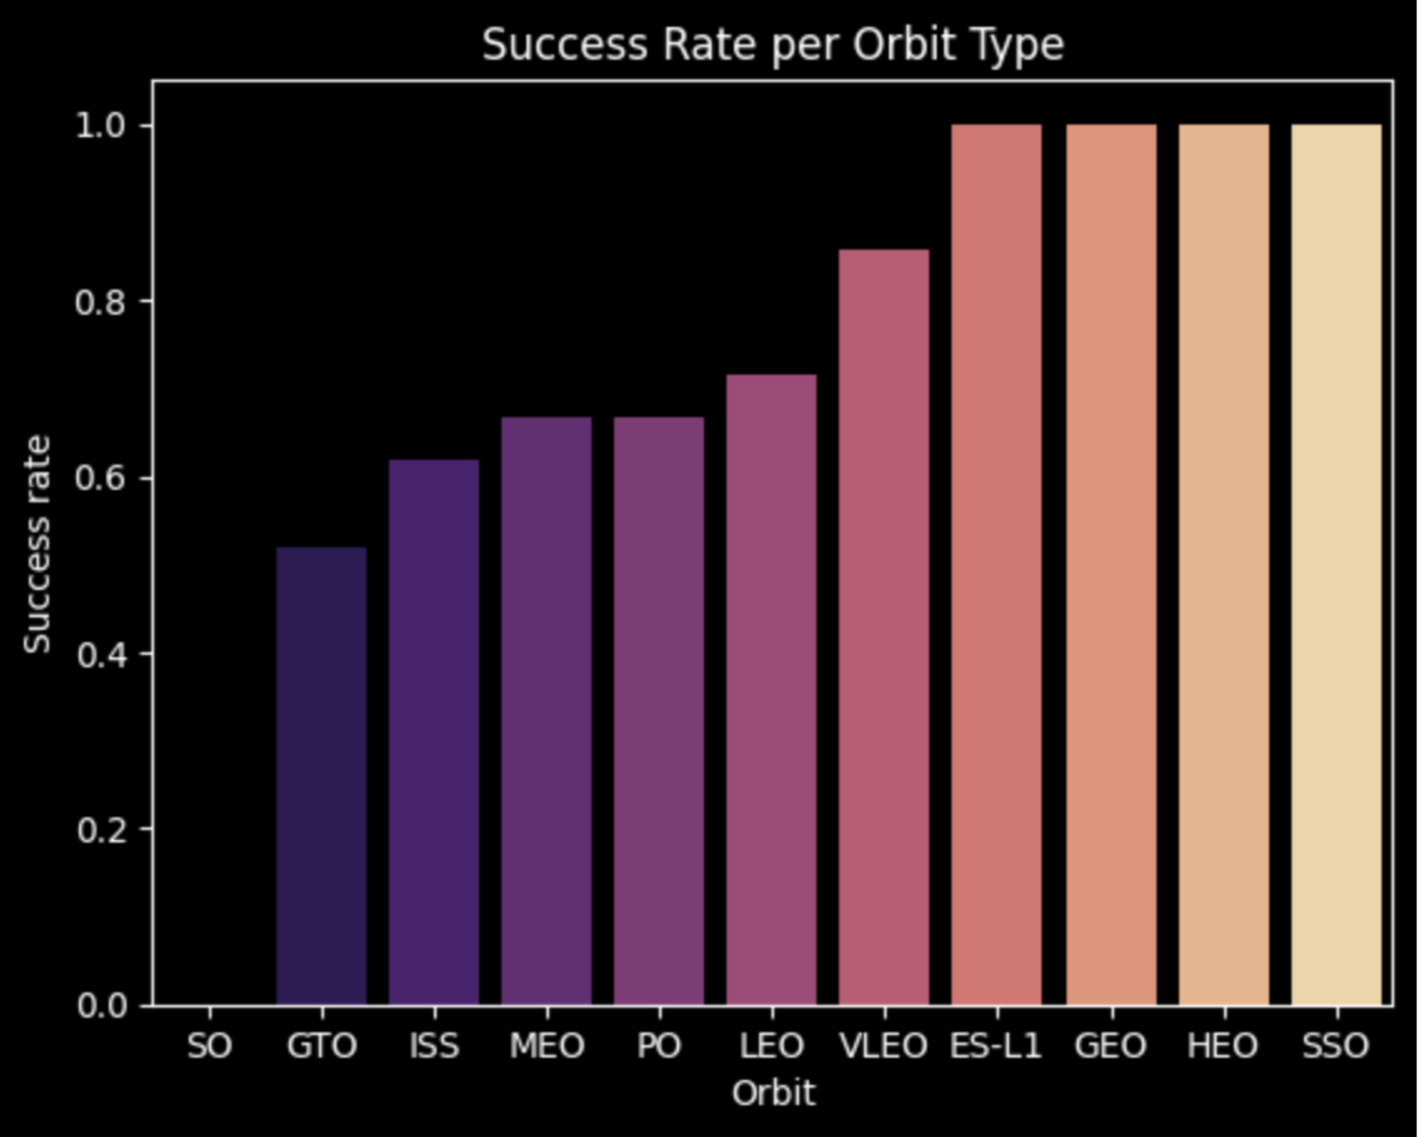
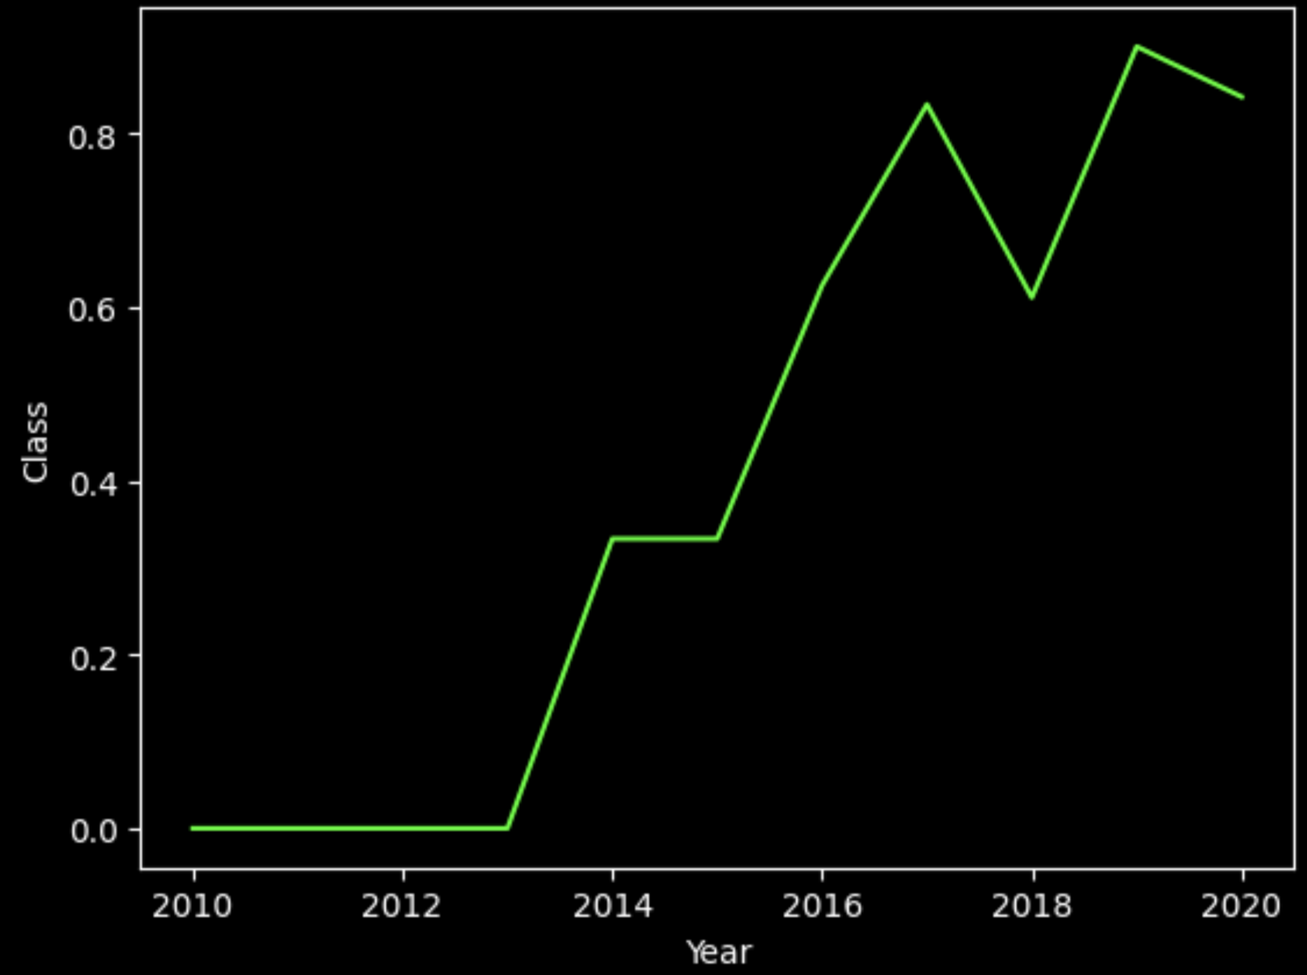
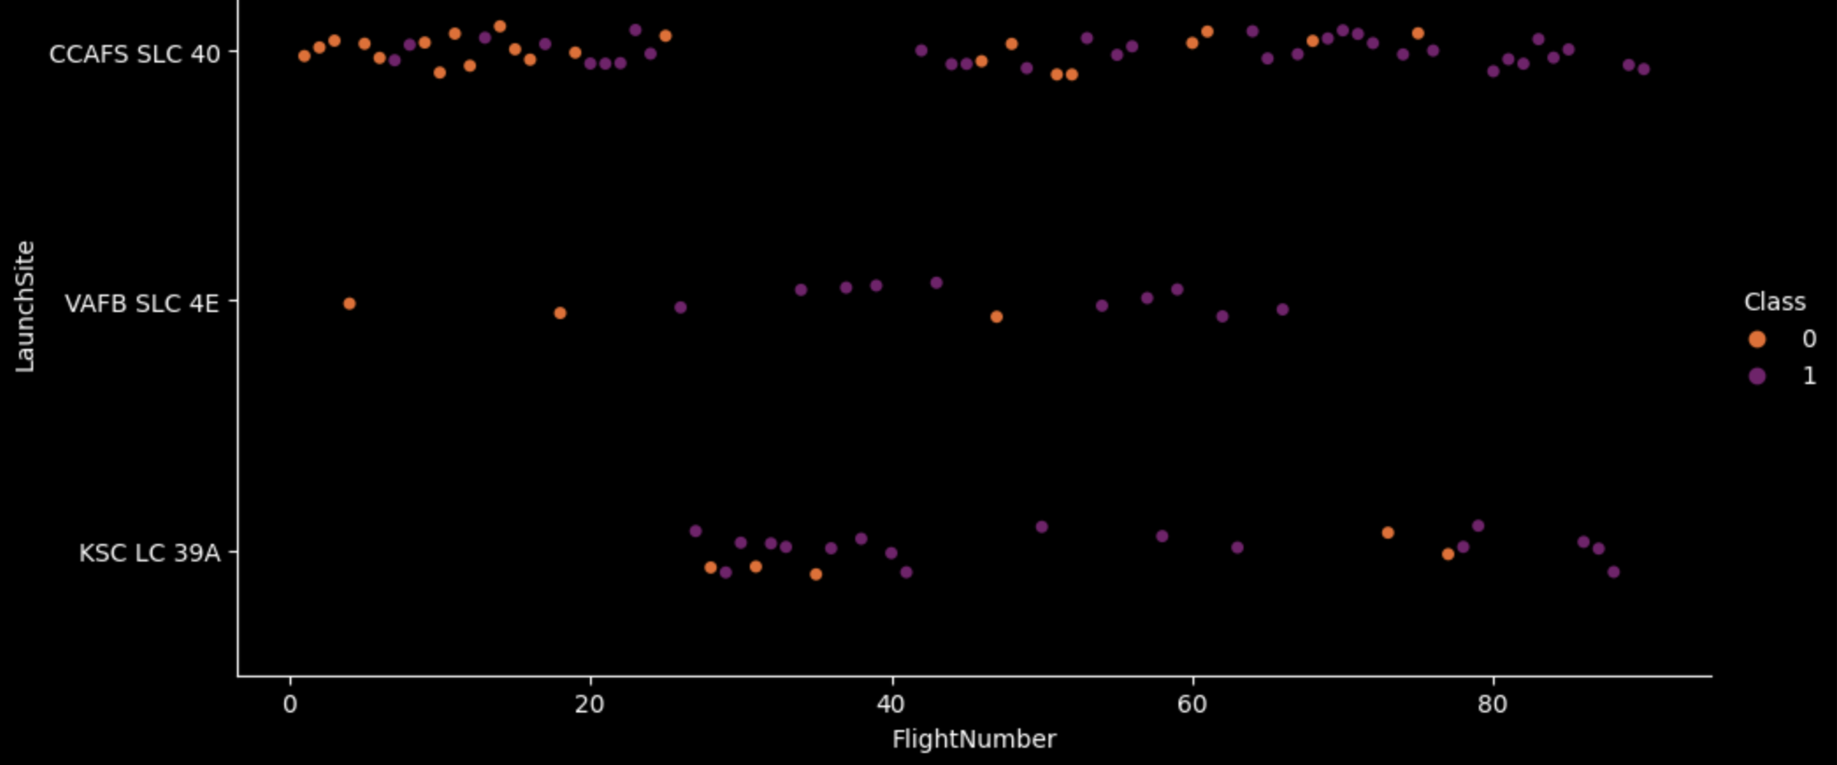
EDA with Data Visualization
Primarily, our focus was on displaying how the payload mass, flight number and year correlated to the orbit types and launch sites for each rocket launch. The success rate, or the target variable, was visualized each time to see how its distribution changed.
We mainly used category plots due to our target variable being categorical, but scatter, bar and line plots were used as well to identify trends, such as the launch success rate over time or the success rates per orbit type.
Success rate per orbit type
Success rate over time
Launch outcomes grouped by launch site & number
GitHub: jupyter-labs-eda-dataviz.ipynb

Slide 12
EDA with SQL
Display the names of the unique launch sites in the space mission
Display 5 records where launch sites begin with "CCA"
Display the total payload mass carried by boosters launched by NASA (CRS)
Display average payload mass carried by booster version F9 v1.1
Get the date when the first successful landing outcome in a ground pad was achieved.
Get the total number of "success" and "failure" mission outcomes
With a subquery, list the names of the booster versions which have carried the maximum payload mass
List the records which will display the month names, failure landing outcomes in a drone ship, booster versions, and launch site for the months in the year 2015.
Rank the count of landing outcomes (such as "Failure (drone ship)" or "Success (ground pad)") between the date 2010-06-04 and 2017-03-20, in descending order.
GitHub: jupyter-labs-eda-sql-coursera_sqllite.ipynb

Slide 13
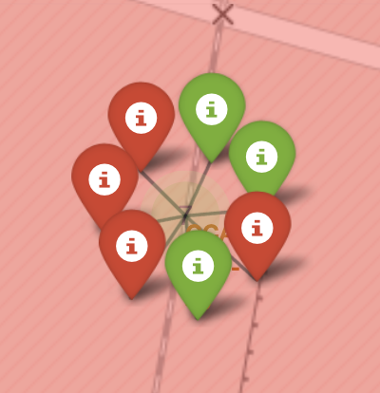
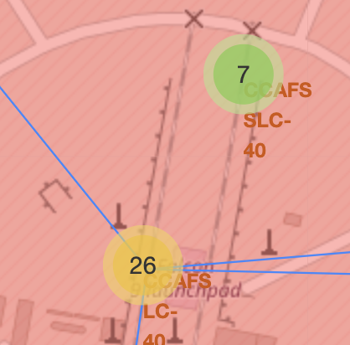
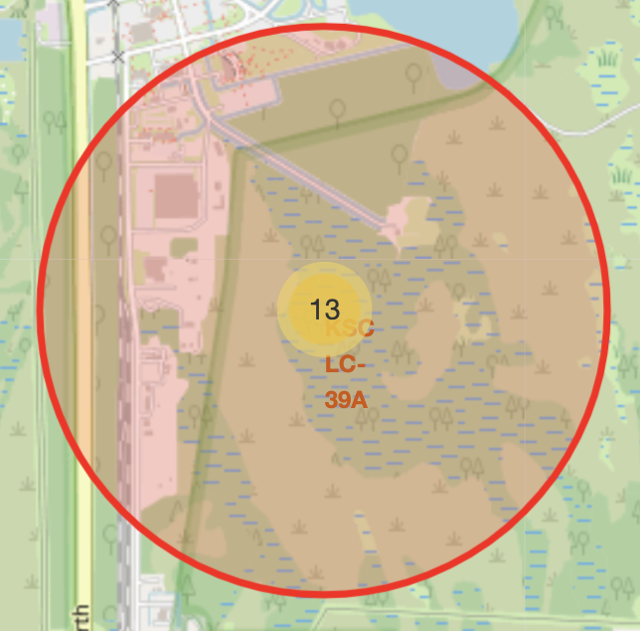
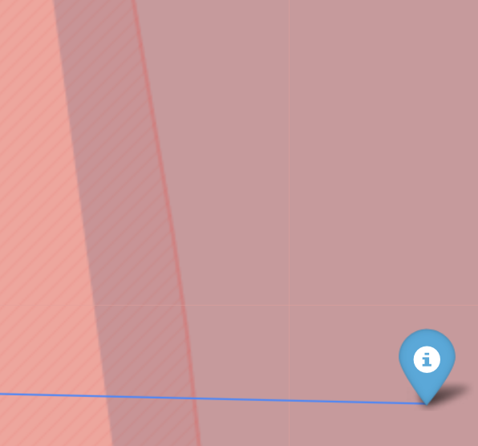
Build an Interactive Map with Folium
Added some elements to our map to better understand and visualize our geographical data:
Markers: Display individual points on the map, such as successful (green), failed (red) rocket launches, and other landmarks such as nearby cities, shores and highways (blue)
Marker clusters: When the map is zoomed out, to be able to easily identify the numberof records in a given geographical site.
Circles: To locate each one of the landing sites of the SpaceX data.
Lines: Trace the nearest path and distance to the nearest landmark markers (blue)
Marker
Marker Cluster
Circle
Line
GitHub: lab_jupyter_launch_site_location.ipynb

Slide 14
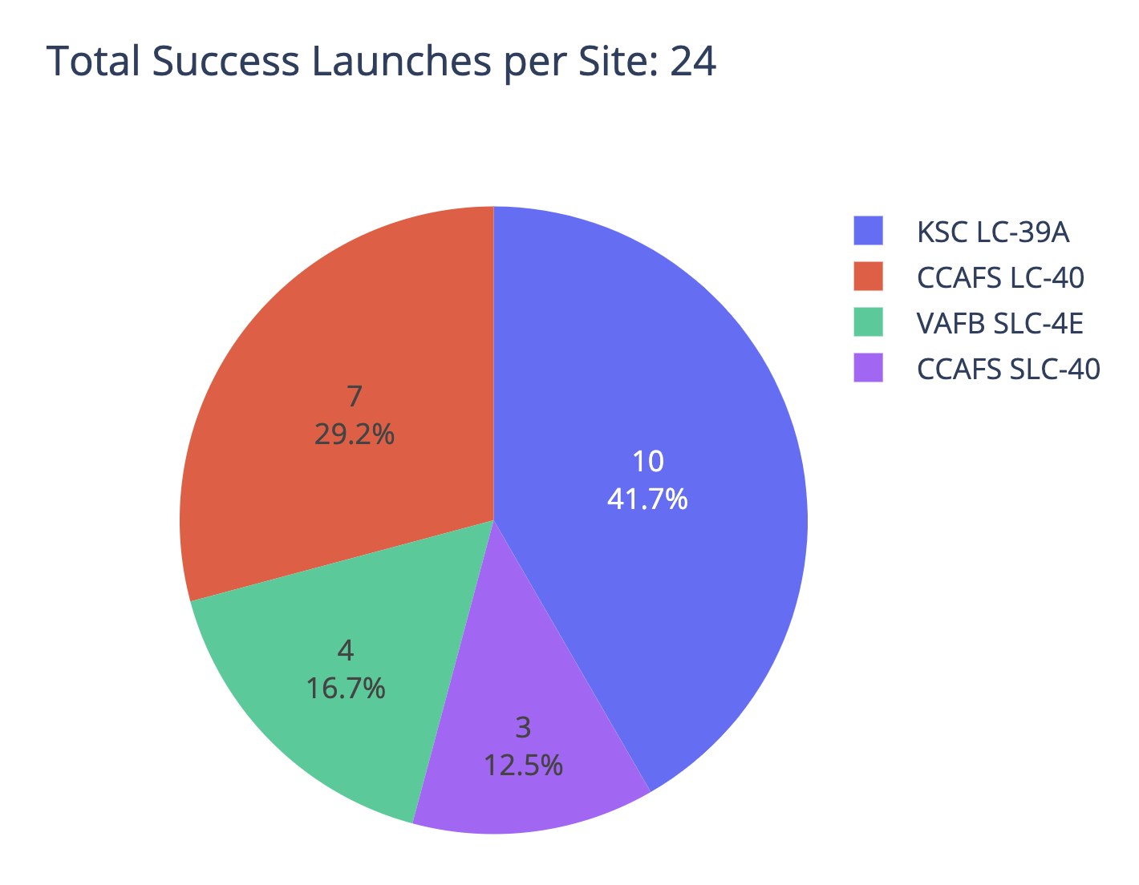
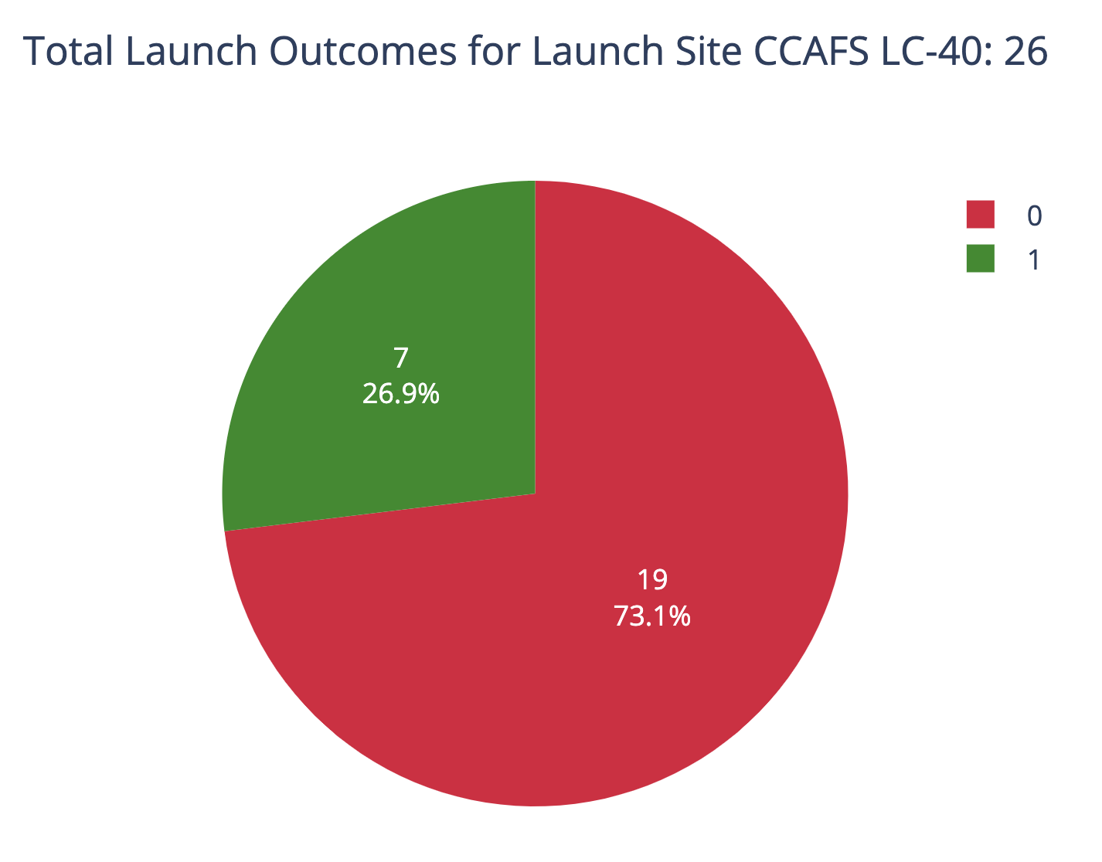
Build a Dashboard with Plotly Dash
The dashboard for the SpaceX launch data includes:
Launch Site Dropdown: Allows users to filter the displayed data by launch site, with an option to view all sites or individual ones.
Pie Chart: Shows the success rate of launches for either all sites¹ or a selected site², providing immediate visual feedback on performance.
Payload Range Slider: Enables users to select a range of payload masses, offering insights into how payload size influences launch outcomes.
Scatter Plot: Correlates payload mass with launch success, highlighting the effectiveness of different booster versions.
GitHub: dash_interactivity.ipynb
1: Total success launches per site
2: Outcomes for launch site

Slide 15









Predictive Analysis (Classification)
To build and select the best-performing classification model, the process included:
Data split: The data was split into 80% training and 20% testing datasets.
Model Selection & Training: Various classification algorithms (Logistic Regression, SVM, Decision Tree, KNN) were trained using GridSearchCV to tune hyperparameters.
Evaluation: The models were evaluated on the test set, and their accuracy scores were stored.
Best Model Identification: The model with the highest accuracy score was identified as the best performer.
80% train
Logistic
Regression
Support Vector Machine
Decision
Tree
K-Nearest Neighbors
hyper-parameter tuning
DataFrame
split
GridSearchCV
20% test
Independent model accuracy and metrics evaluation
GitHub: SpaceX_Machine_Learning_Prediction_Part_5.jupyterlite.ipynb

Slide 16
Results
Exploratory Data Analysis Results:
Visualized the relationships between variables such as payload mass, flight number, year, and launch site, understanding how these factors correlate with launch success rates.
Analyzed data through various types of plots, such as category plots, scatter and line plots; revealing trends and distributions, such as the variance in success rate by orbit type and its evolution over time.
Predictive analysis results
Trained several classification models (Logistic Regression, SVM, Decision Tree, and KNN) with an 80/20 train-test split.
Hyperparameter tuning was performed using GridSearchCV to optimize the models.
The models' performances were compared based on accuracy, and the best model was identified as the one with the highest accuracy on the test set.

Slide 17
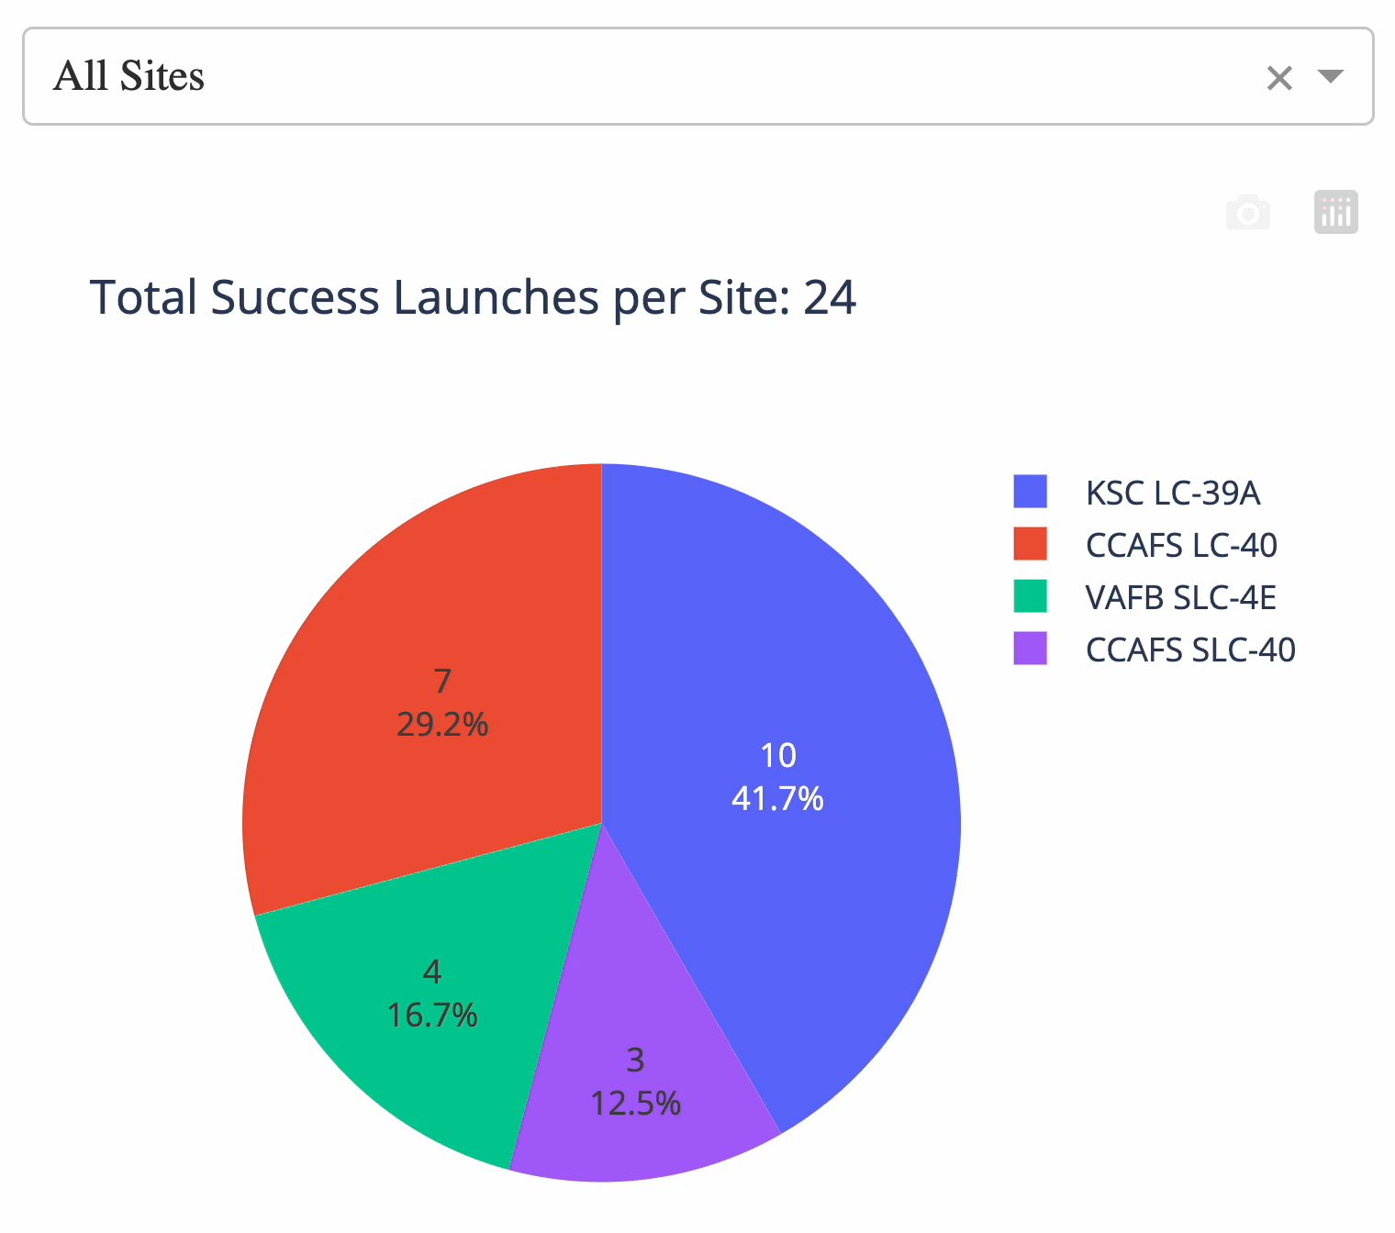
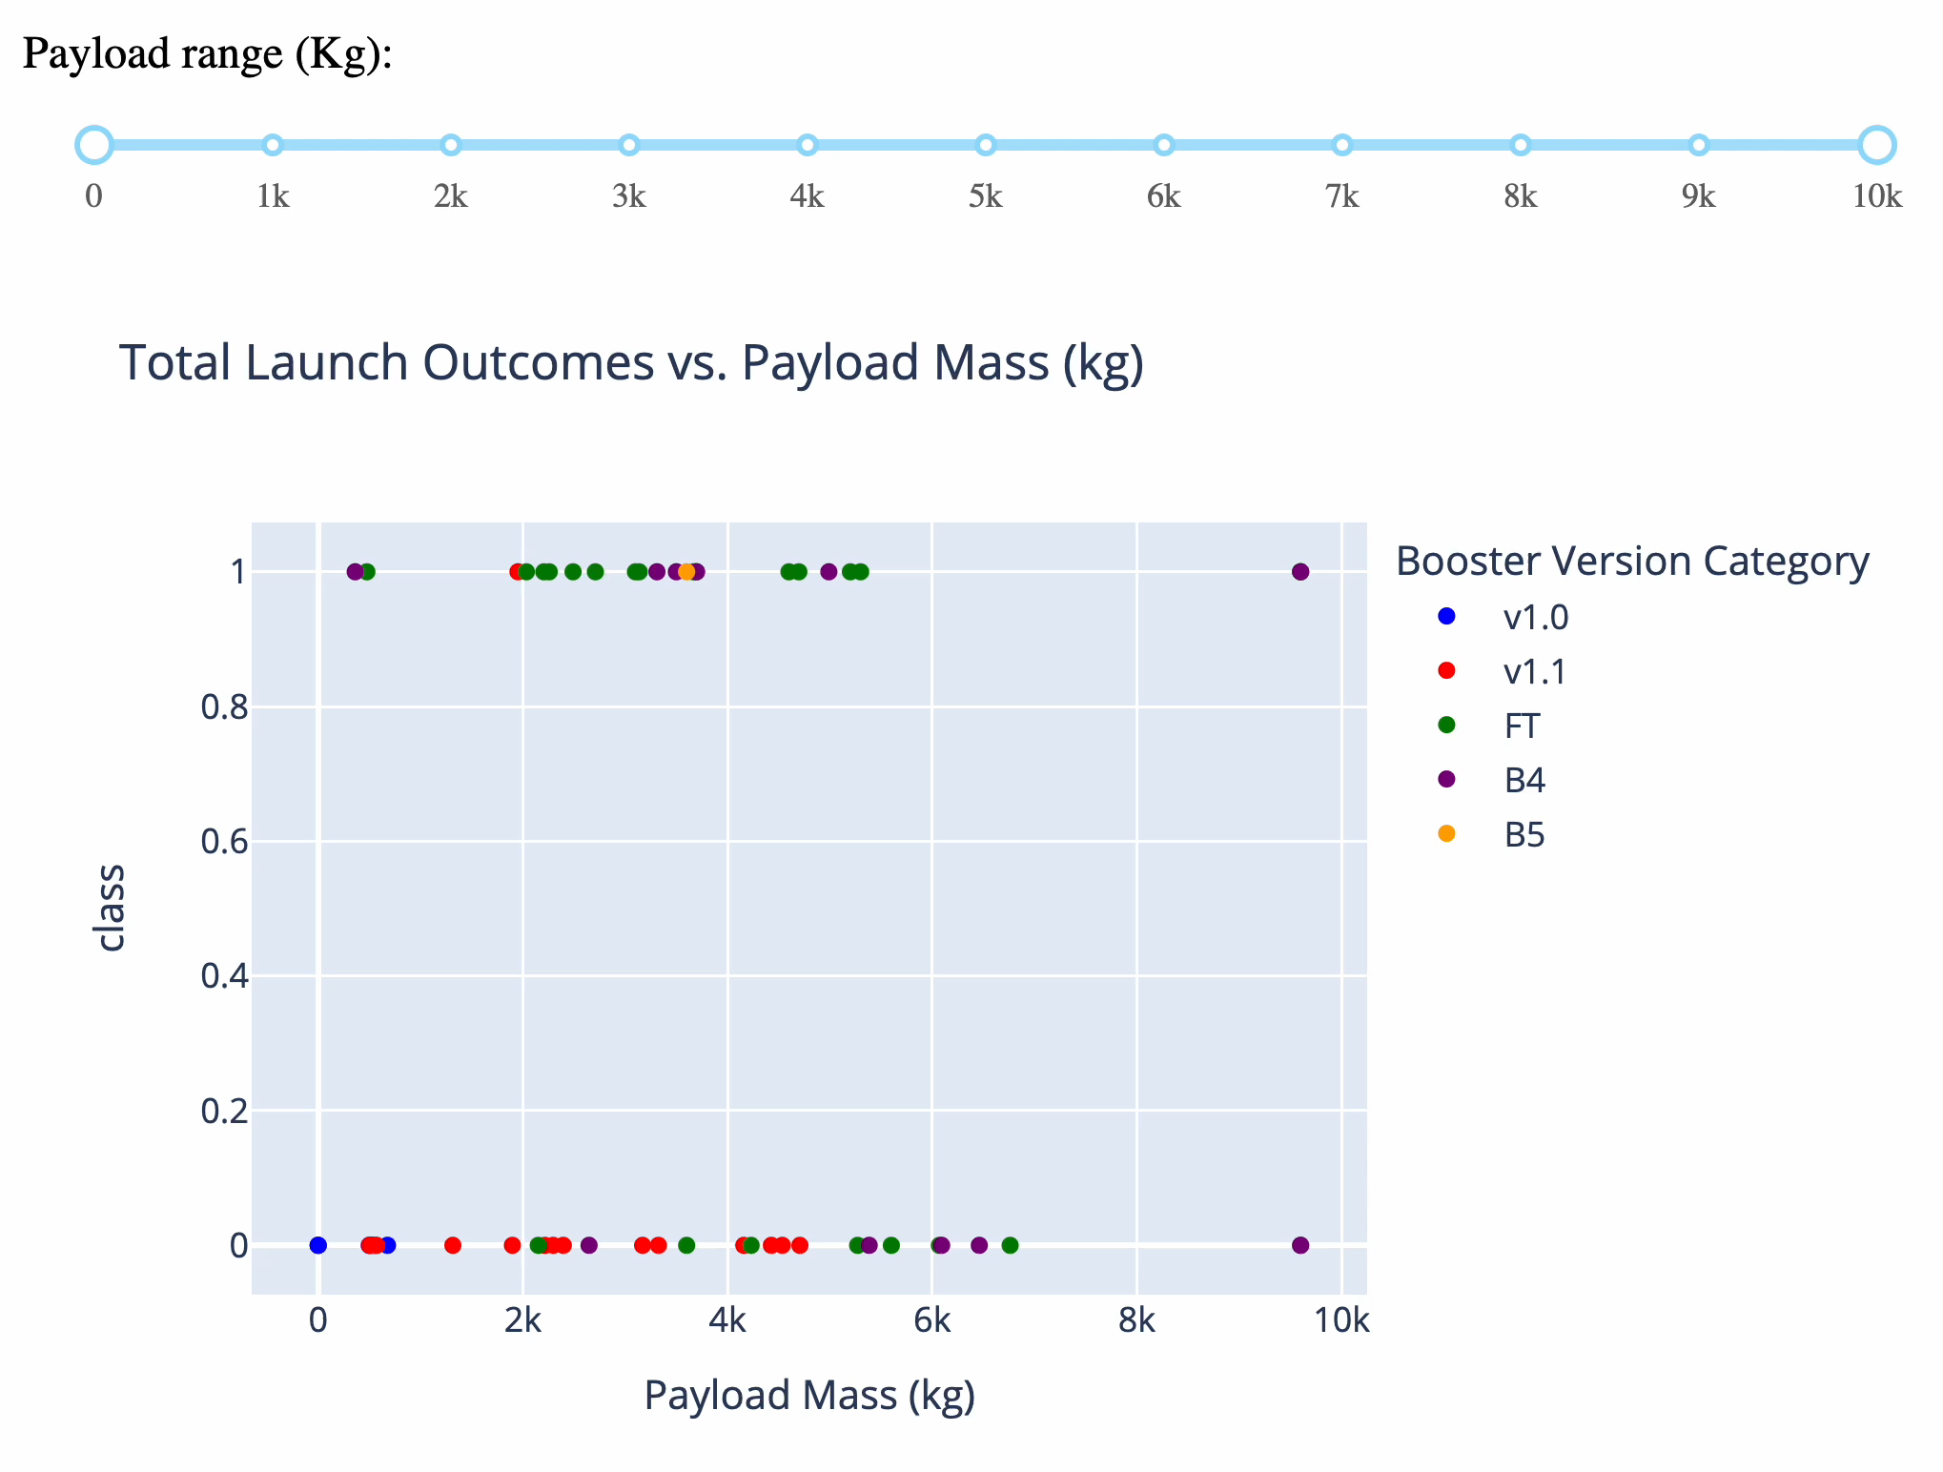
Results
Interactive Analytics Demo
Get success % for each or all launch sites
Filter by launch site and payload mass in real time

Slide 18

Section 2

Slide 19
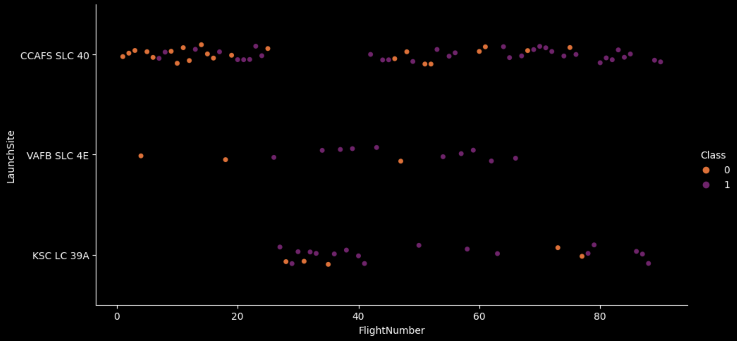
Flight Number vs. Launch Site
Although the graph shows that the success possibilities of a launch increase along with the flight number, there doesn't seem to be a lot of difference when the launch site changes.
Flight Number vs. Launch Site Category Plot

Slide 20
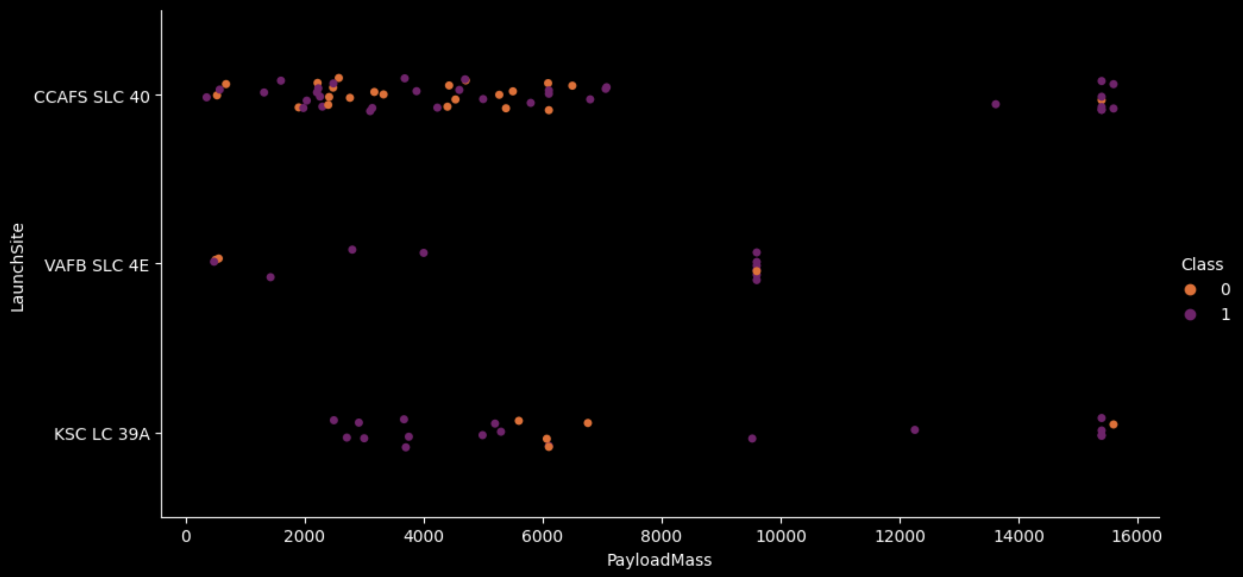
Payload vs. Launch Site
The graph shows that the probability of a failed launch outcome increases when the payload mass is around 500-7,000kg for the "CCAFS SLC-40" launch site, and 5,750-7,000 for "KSC LC 39A".
Payload Mass vs. Launch Site Category Plot

Slide 21
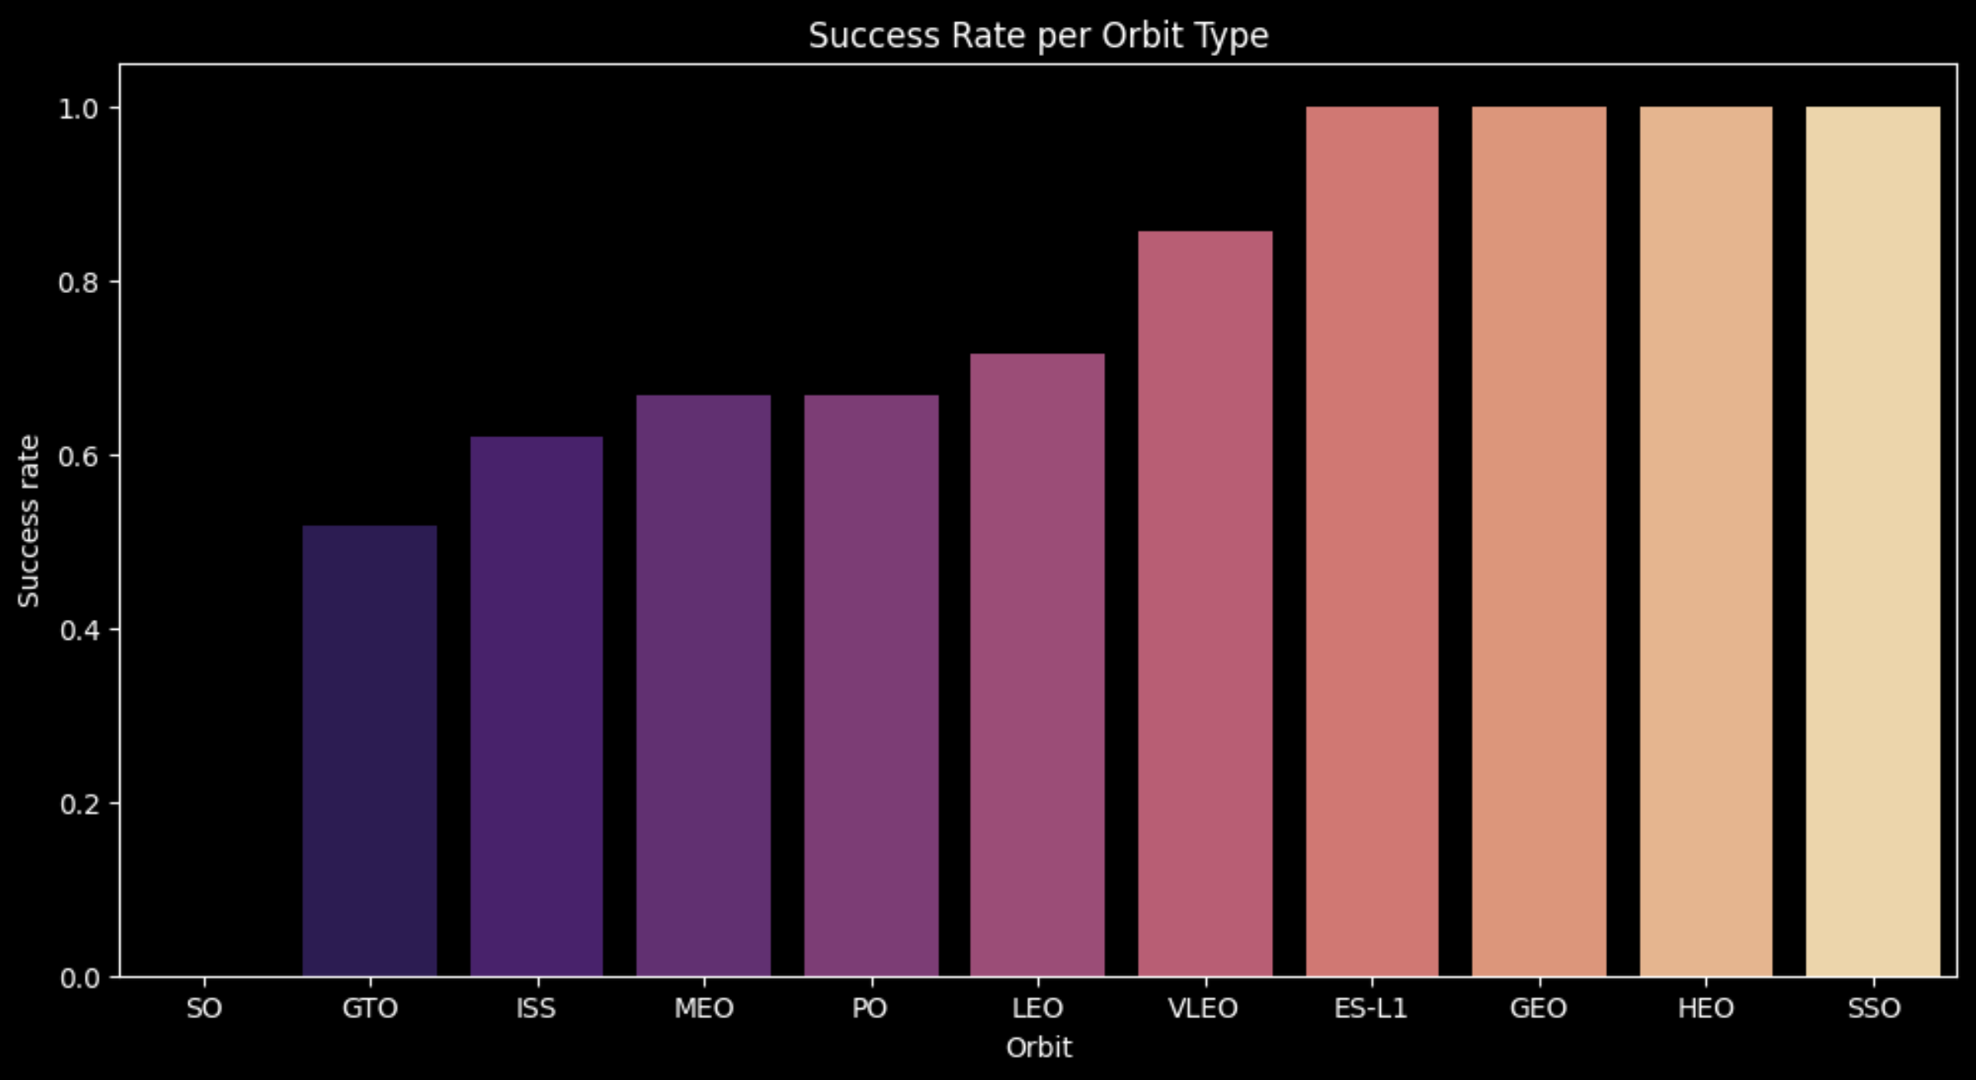
Success Rate vs. Orbit Type
ES-L1, GEO, HEO and SSO orbits have a success probability of 100%, while SO has a 0%. The mode success probability is around 70%.
Orbit Type vs. Success Rate Bar Plot

Slide 22
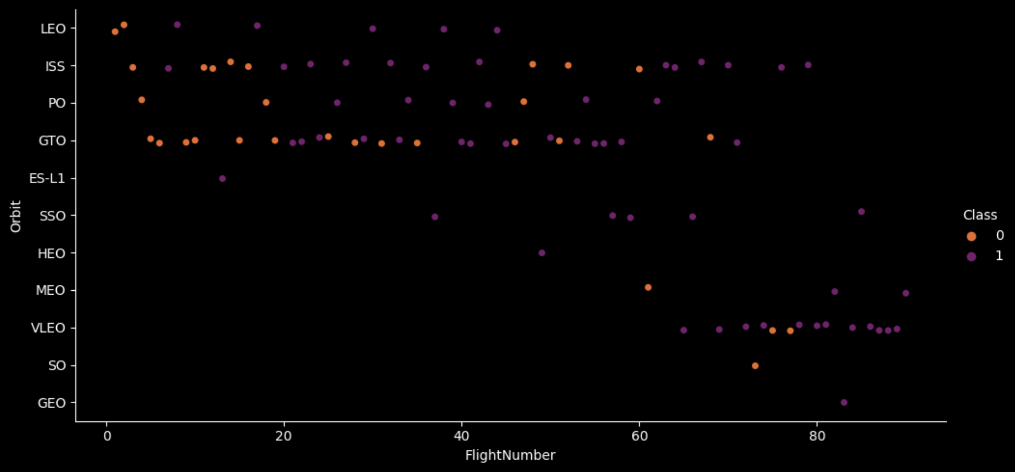
Flight Number vs. Orbit Type
There appears to be a tendency for ISS and GTO orbits that contradict our theory proposed in slide #19, having more failures than usual. Also, as the flight number increases, certain orbits alternate in being reached or not by the rocket.
Flight Number vs. Orbit type Category Plot

Slide 23
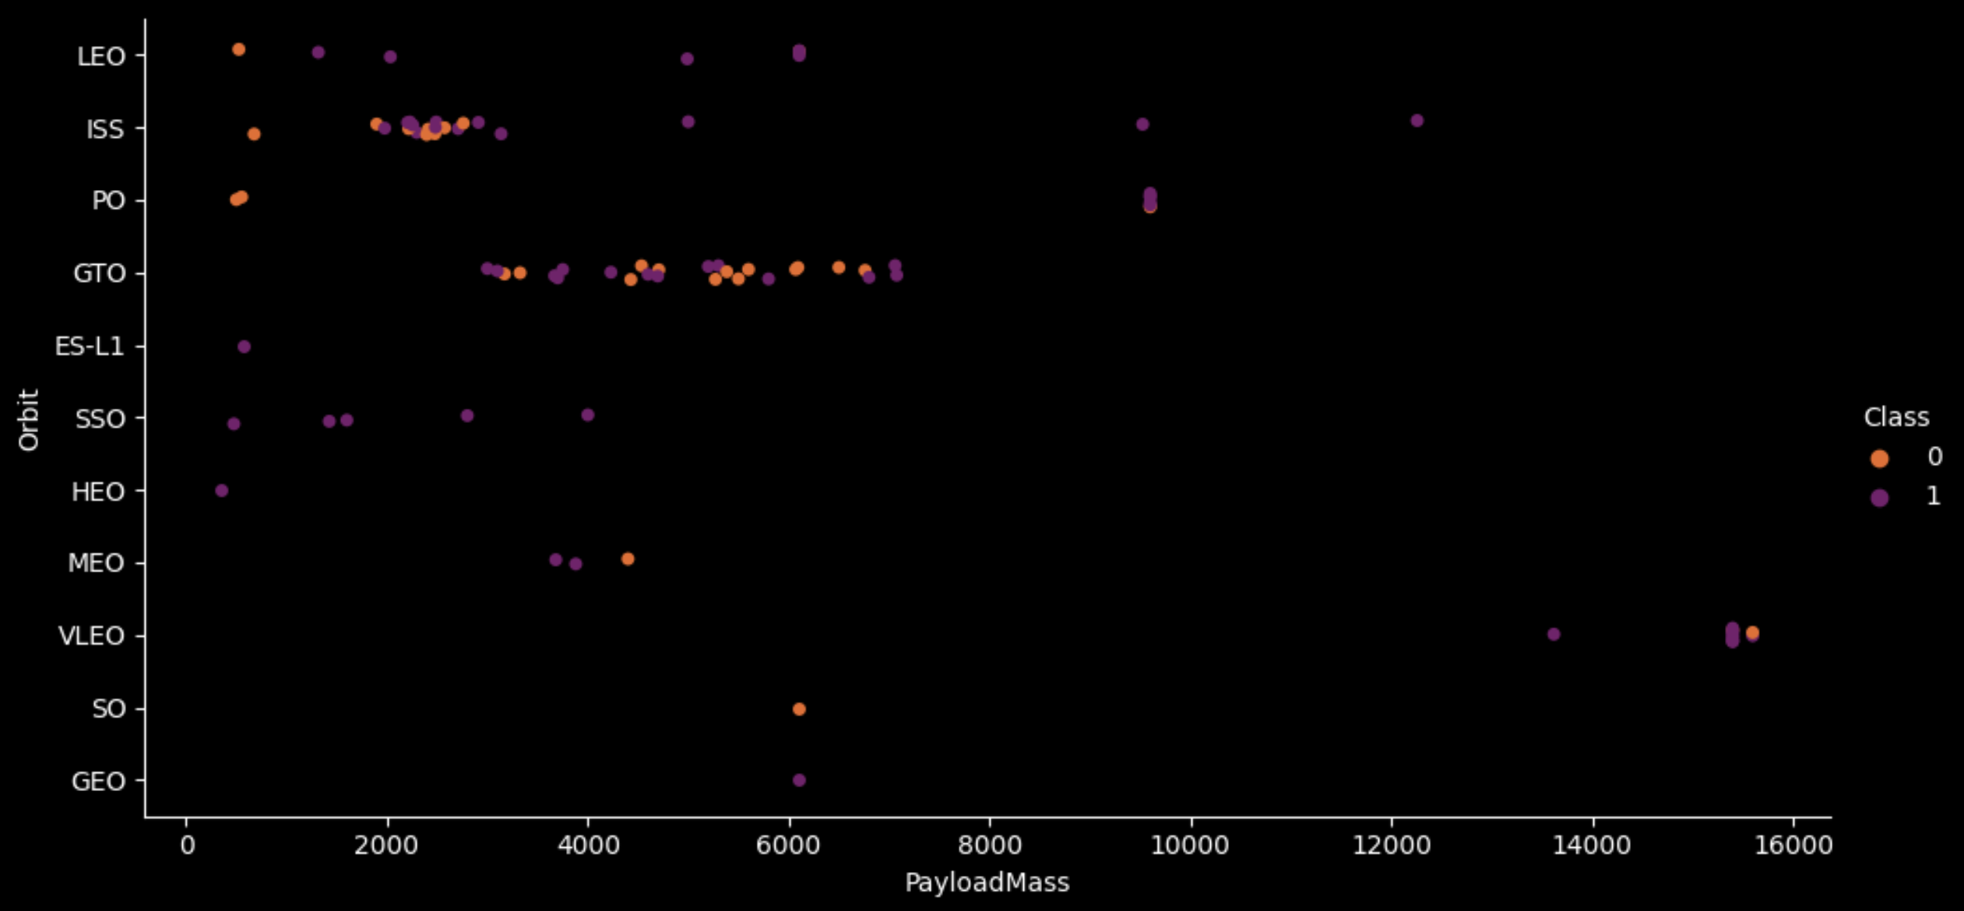
Payload vs. Orbit Type
The most common payload mass and orbit type for our launches are 3,000-7,000kg for GTO, and 2,000-3,500kg for ISS. They are also the most prone to fail. The best and most consistent option seems to be the SSO orbit with payload mass around 500-4,000kg.
Payload Mass vs. Orbit type Category Plot

Slide 24
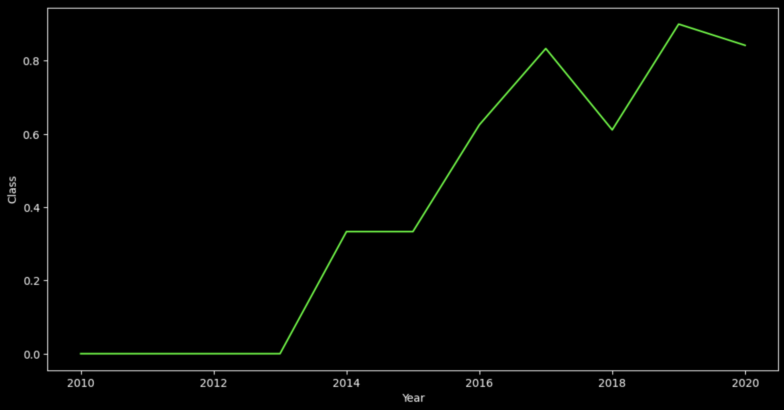
Launch Success Yearly Trend
This line graph confirms our theory that the success rate probability increases over launch number, hence time, as it is inherently correlated with it.
Launch Success Yearly Trend Line Plot

Slide 25
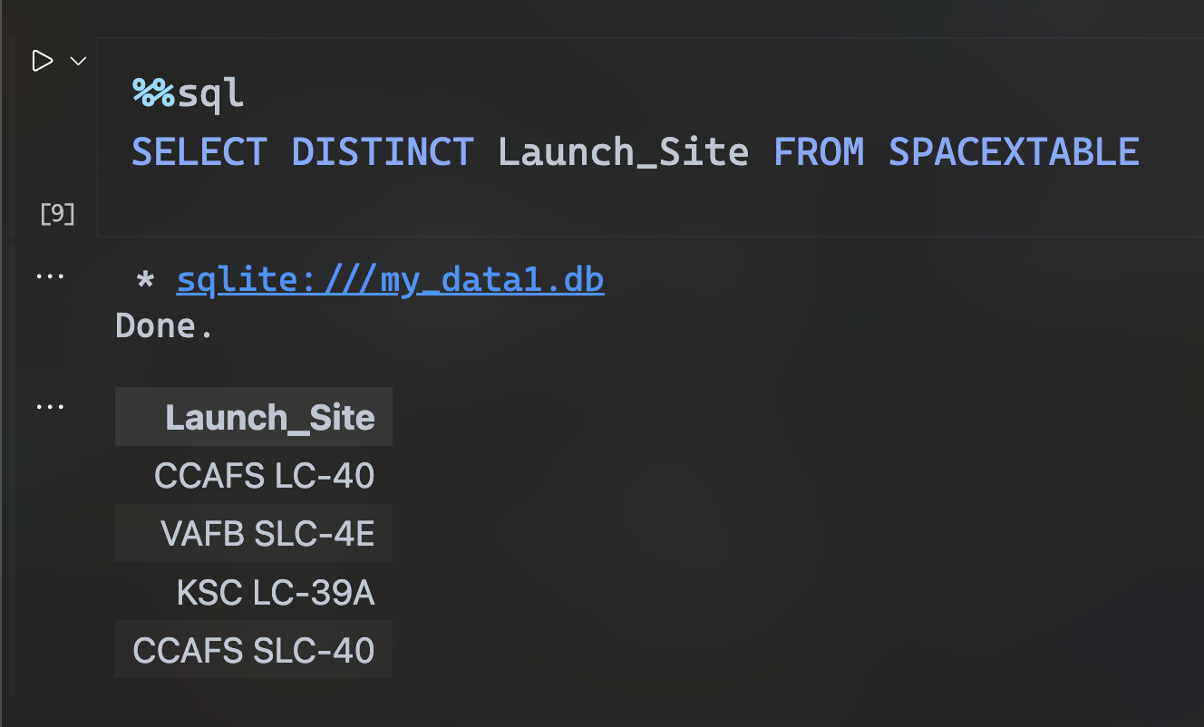
All Launch Site Names
This SQL query returns the different launch site names by using the SELECT DISTINCT command.
SQL EDA: Task 1

Slide 26
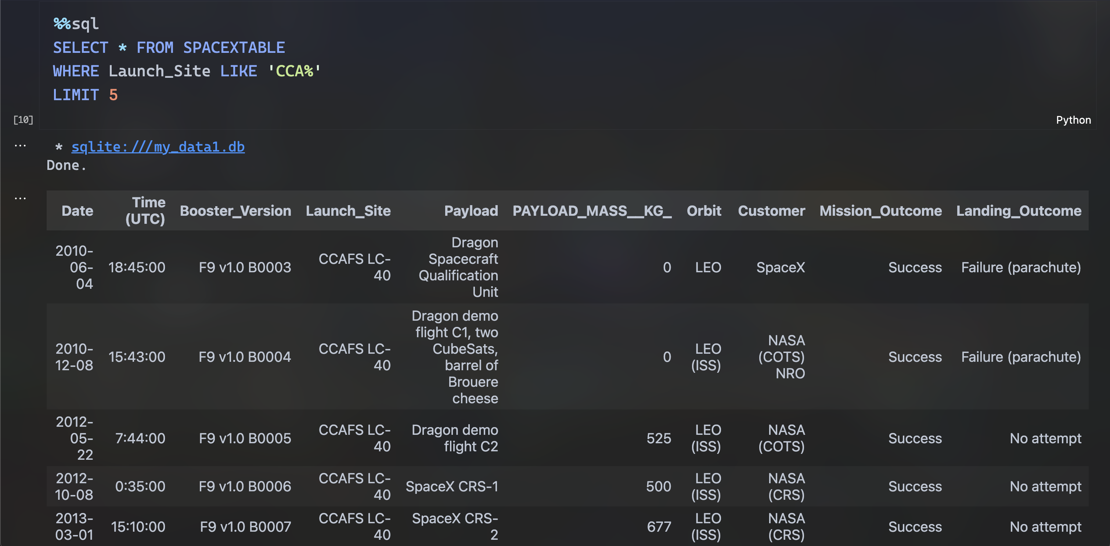
Launch Site Names Begin with 'CCA'
This SQL query returns 5 records of launches having the NASA as their clients
SQL EDA: Task 2

Slide 27
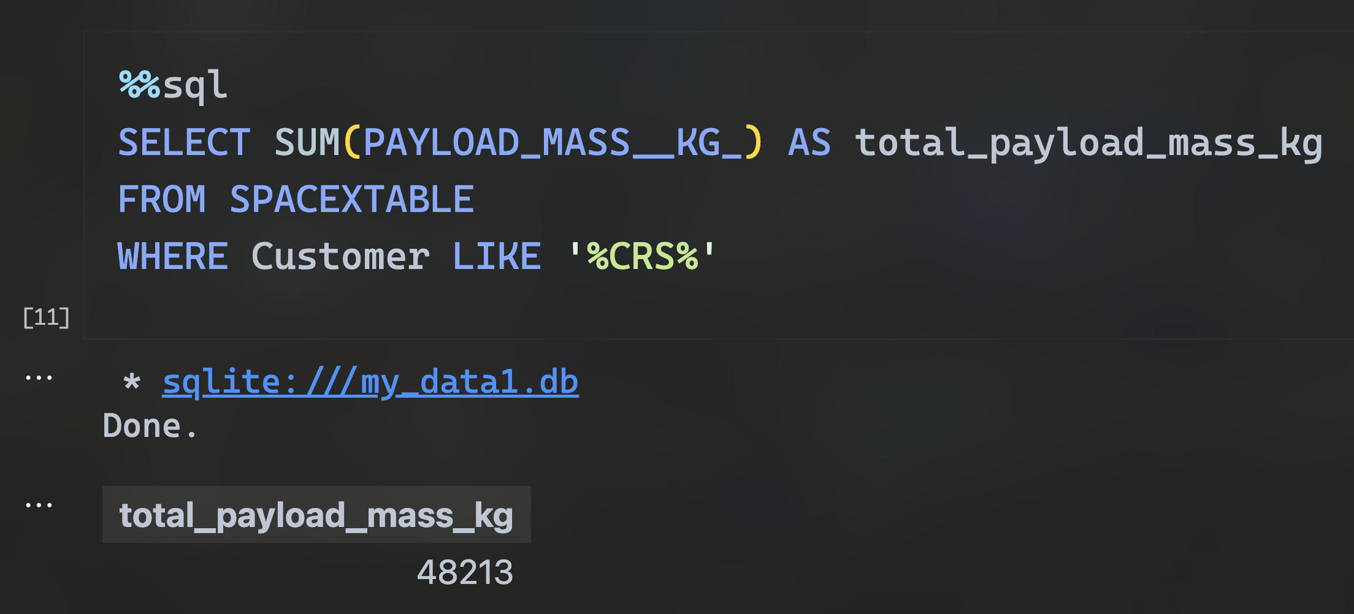
Total Payload Mass
This SQL query displays the total payload mass (in kilograms) for all launches having the NASA as their clients: 48,213kg.
SQL EDA: Task 3

Slide 28
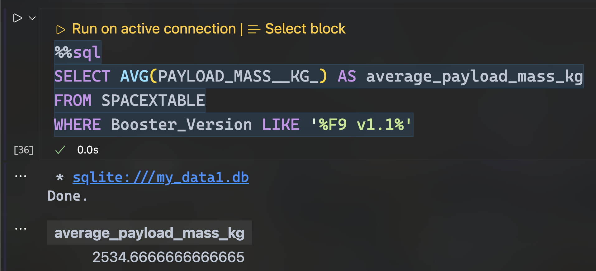
Average Payload Mass by F9 v1.1
This SQL query returns the average payload mass for all the launches with booster version F9 v1.1, 2,534.667kg.
SQL EDA: Task 4

Slide 29
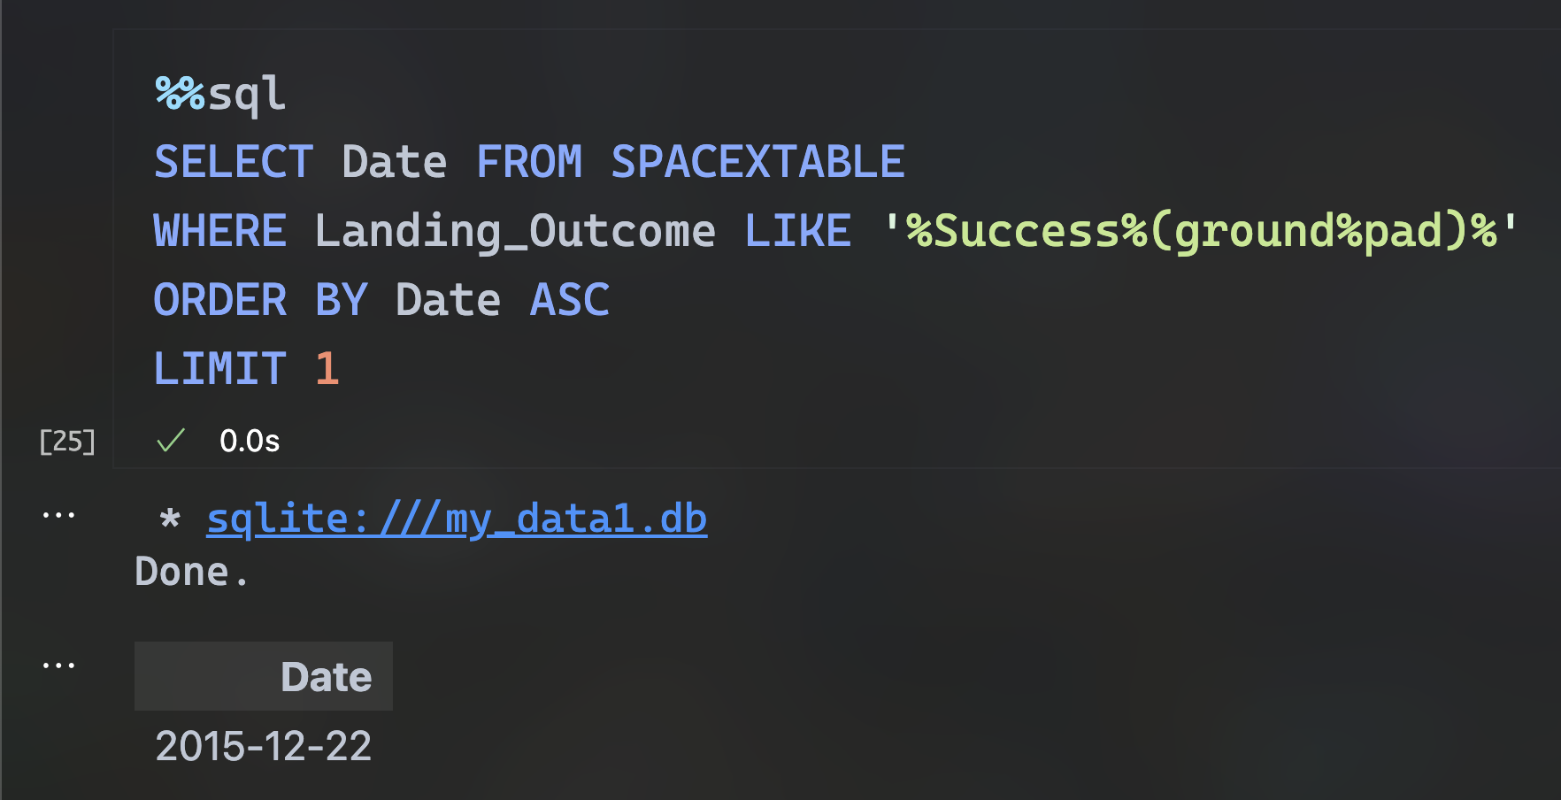
First Successful Ground Landing Date
This SQL query retrieves the date of the first successful rocket launch in a ground pad: 22/December/2015. Almost a Christmas gift!
SQL EDA: Task 5

Slide 30
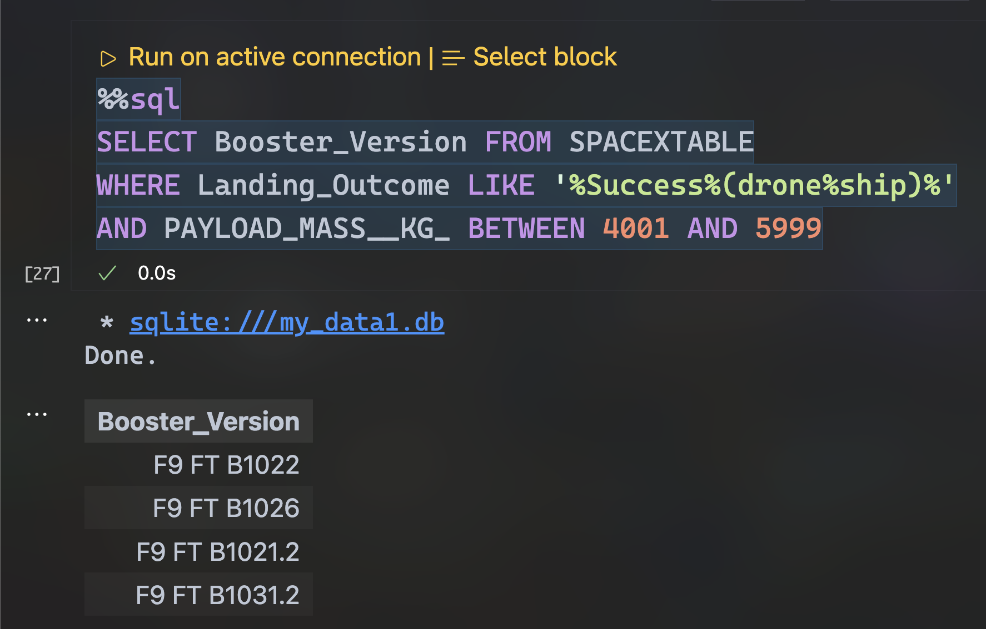
Successful Drone Ship Landing with Payload between 4000 and 6000
This SQL query retrieves all of the booster version names that have had success in a drone ship landing space, where their payload mass is between 4,000 and 6,000 kilograms.
SQL EDA: Task 6

Slide 31
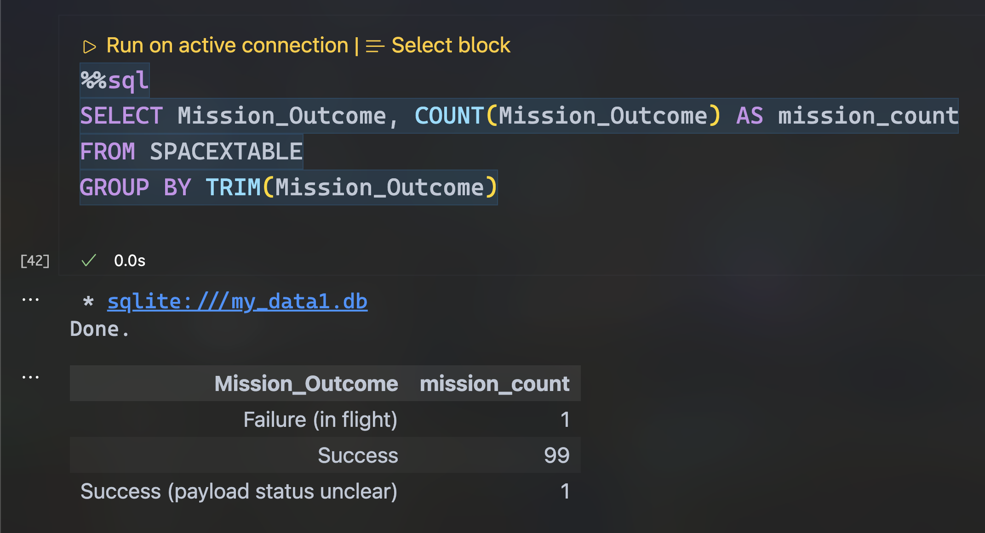
Total Number of Successful and Failure Mission Outcomes
We see that most of the mission outcomes of these launches went overall successful, having a 99.01% probability of it.
SQL EDA: Task 7

Slide 32
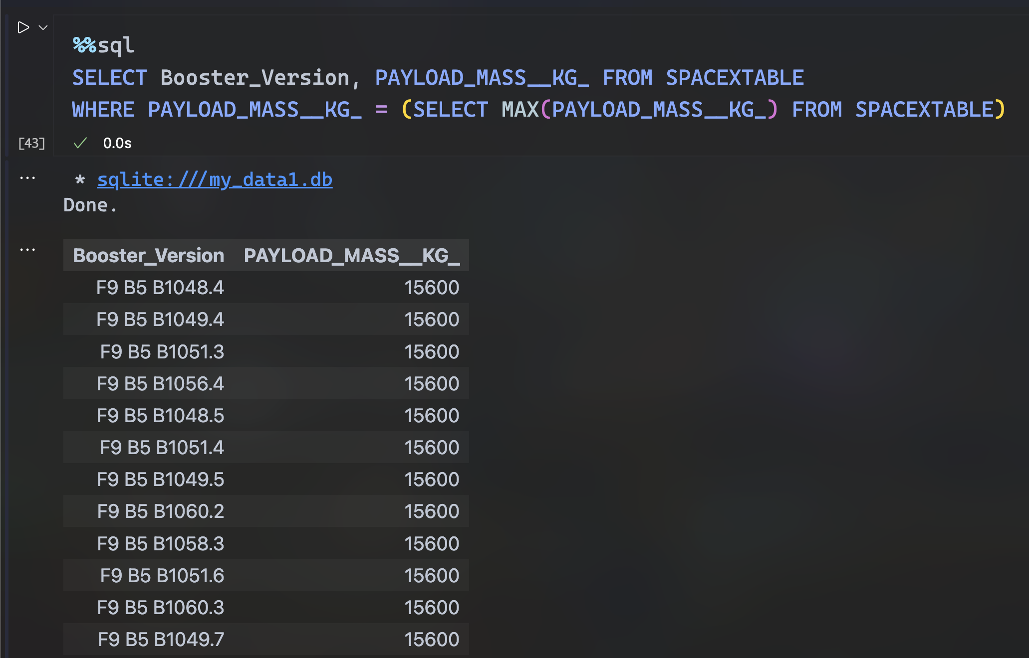
Boosters Carried Maximum Payload
This SQL query retrieves all of the booster version names which have carried the maximum amount of payload mass in the data at least once. A subquery is used in order to correctly filter the information out.
SQL EDA: Task 8

Slide 33
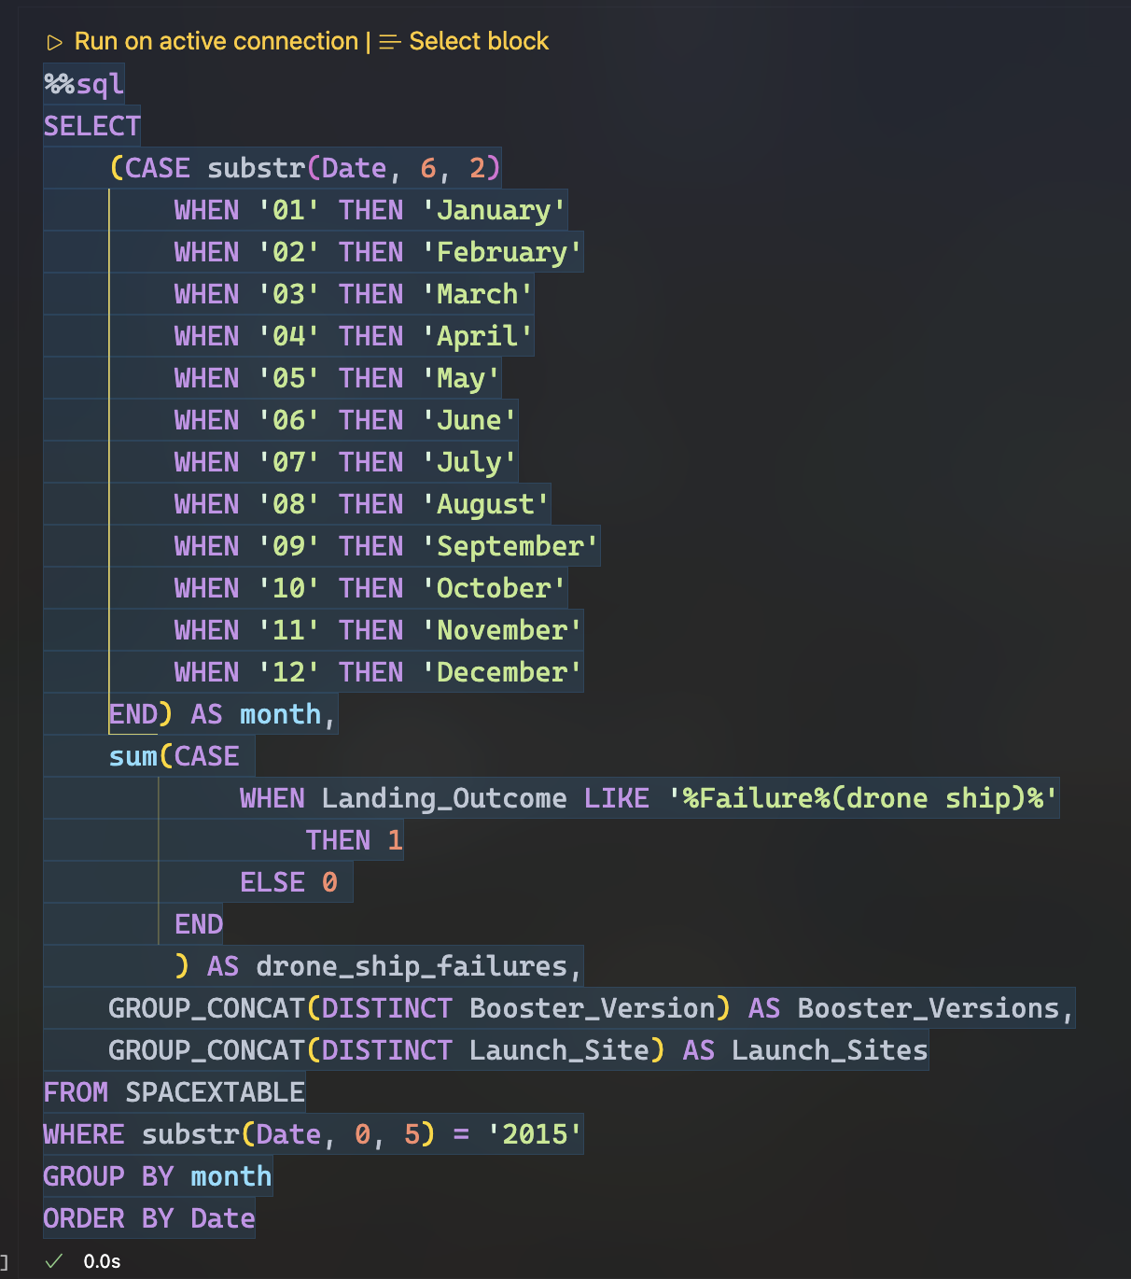
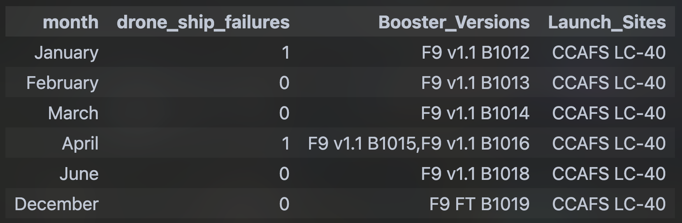
2015 Launch Records
For this SQL query, two CASES are performed: the first one to get the month number and convert it into text in the results, and the second one to sum the amount of failed landing outcomes in drone ship landing spaces, contemplating them for each distinct booster versions and launch sites, which are concatenated to show all of their features in a single line, and only have one register per month.
The information is finally filtered for the year 2015, grouped by the "month" column we just defined in line 16, and in descending order using the "Date" column.
SQL EDA: Task 9 (query)
SQL EDA: Task 9 (result)

Slide 34
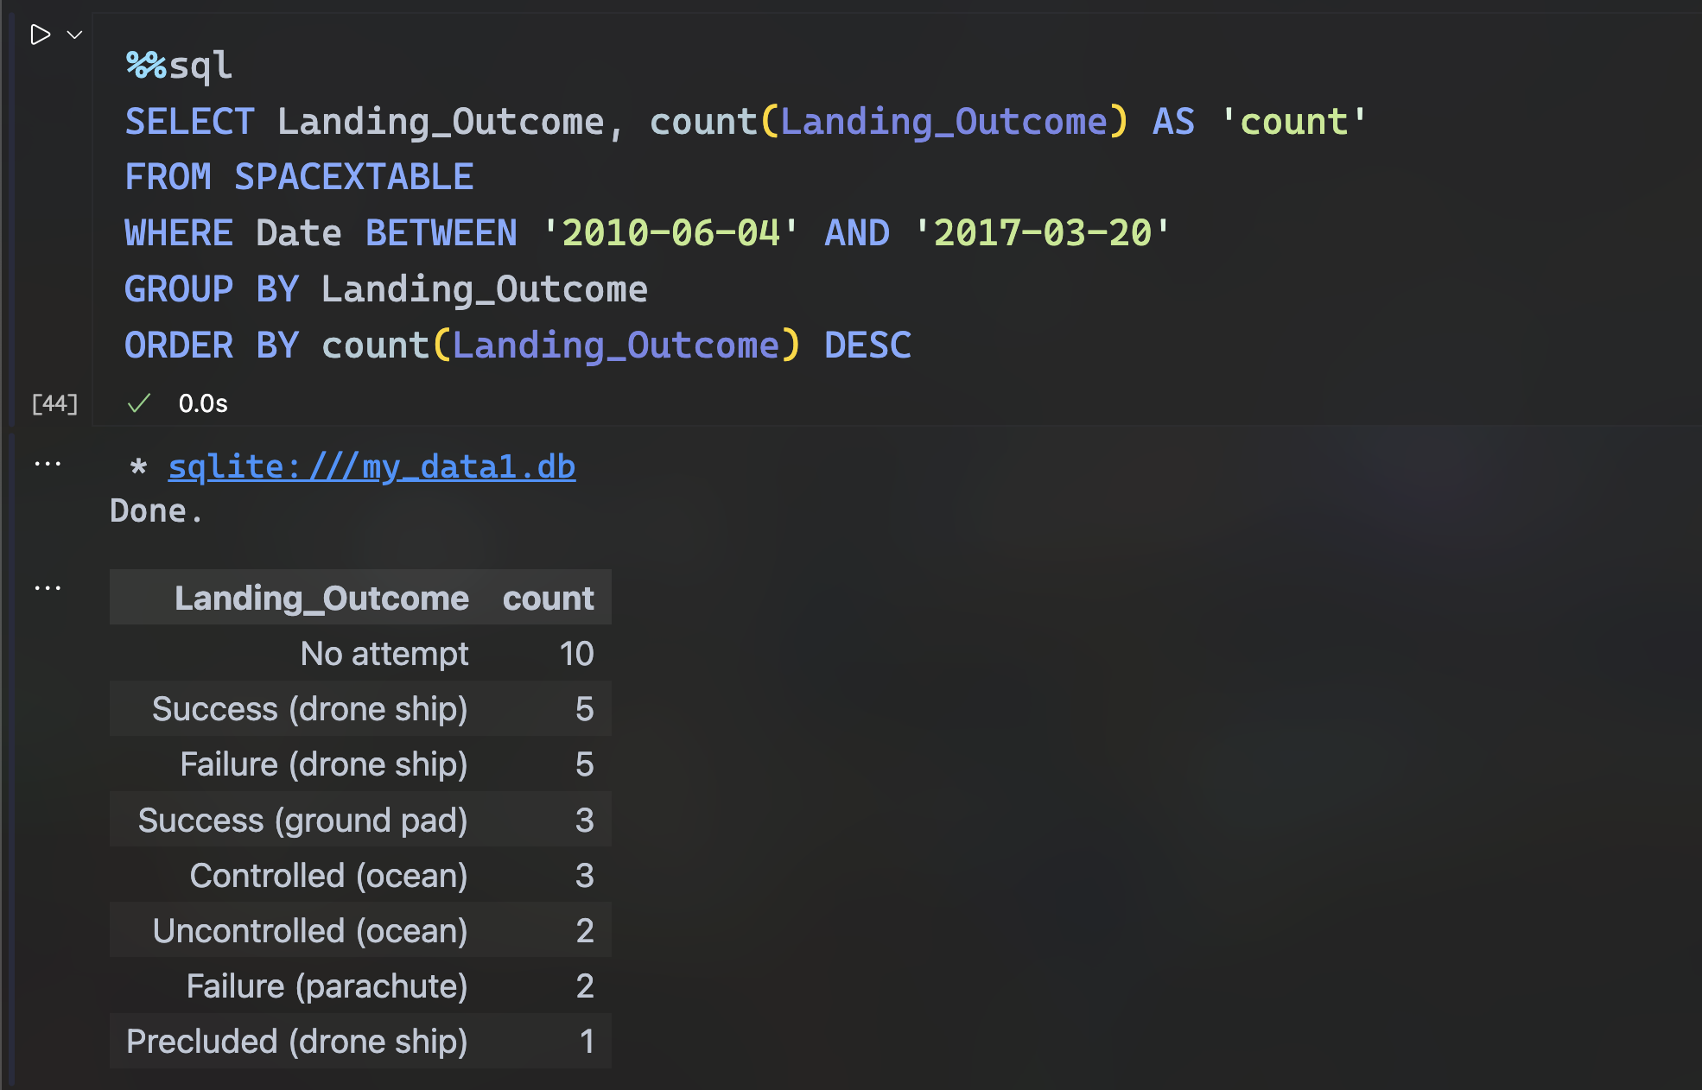
Rank Landing Outcomes Between 2010-06-04 and 2017-03-20
This SQL query displays that, between the dates 04/June/2010 and 20/March/2017, most of the landing outcomes were "no attempt": 10, "Success (drone ship)": 5 and "Failure (drone ship)": 5.
SQL EDA: Task 10

Slide 35

Section 3

Slide 36
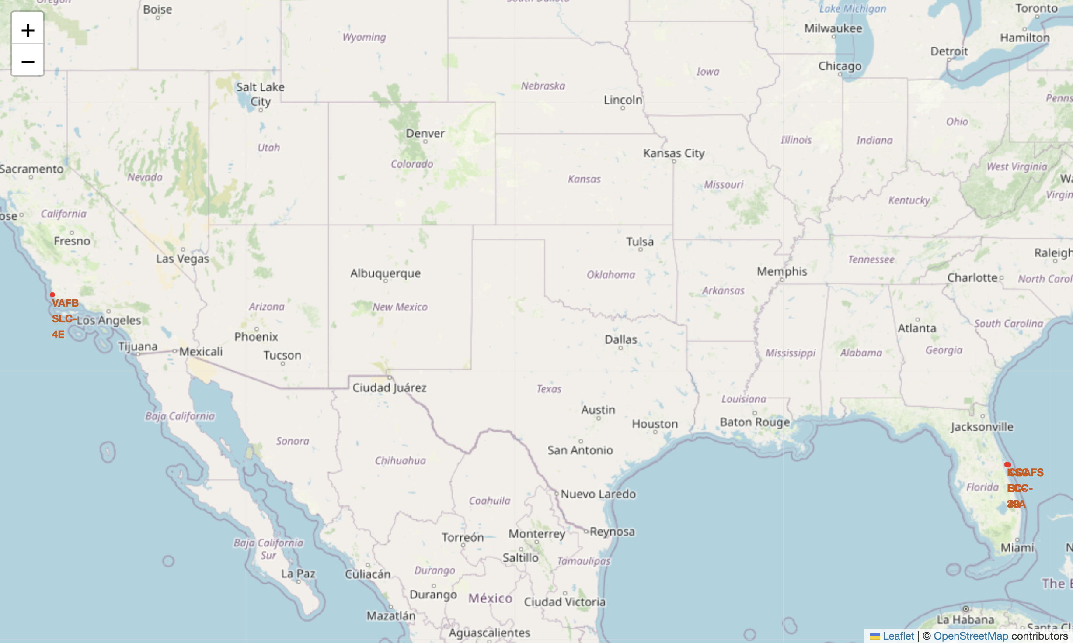
SpaceX Launch Sites
The map displays SpaceX launch sites, strategically positioned near coastlines and transport paths, yet isolated from populated areas for safety. Apart from "VAFB SLC-4E", the sites are in close proximity, making individual site identification on the map difficult due to their tight clustering.
VVAFB SLC-4E
KSC LC-39A
CCAFS SLC-40
CCAFS LC-40

Slide 37
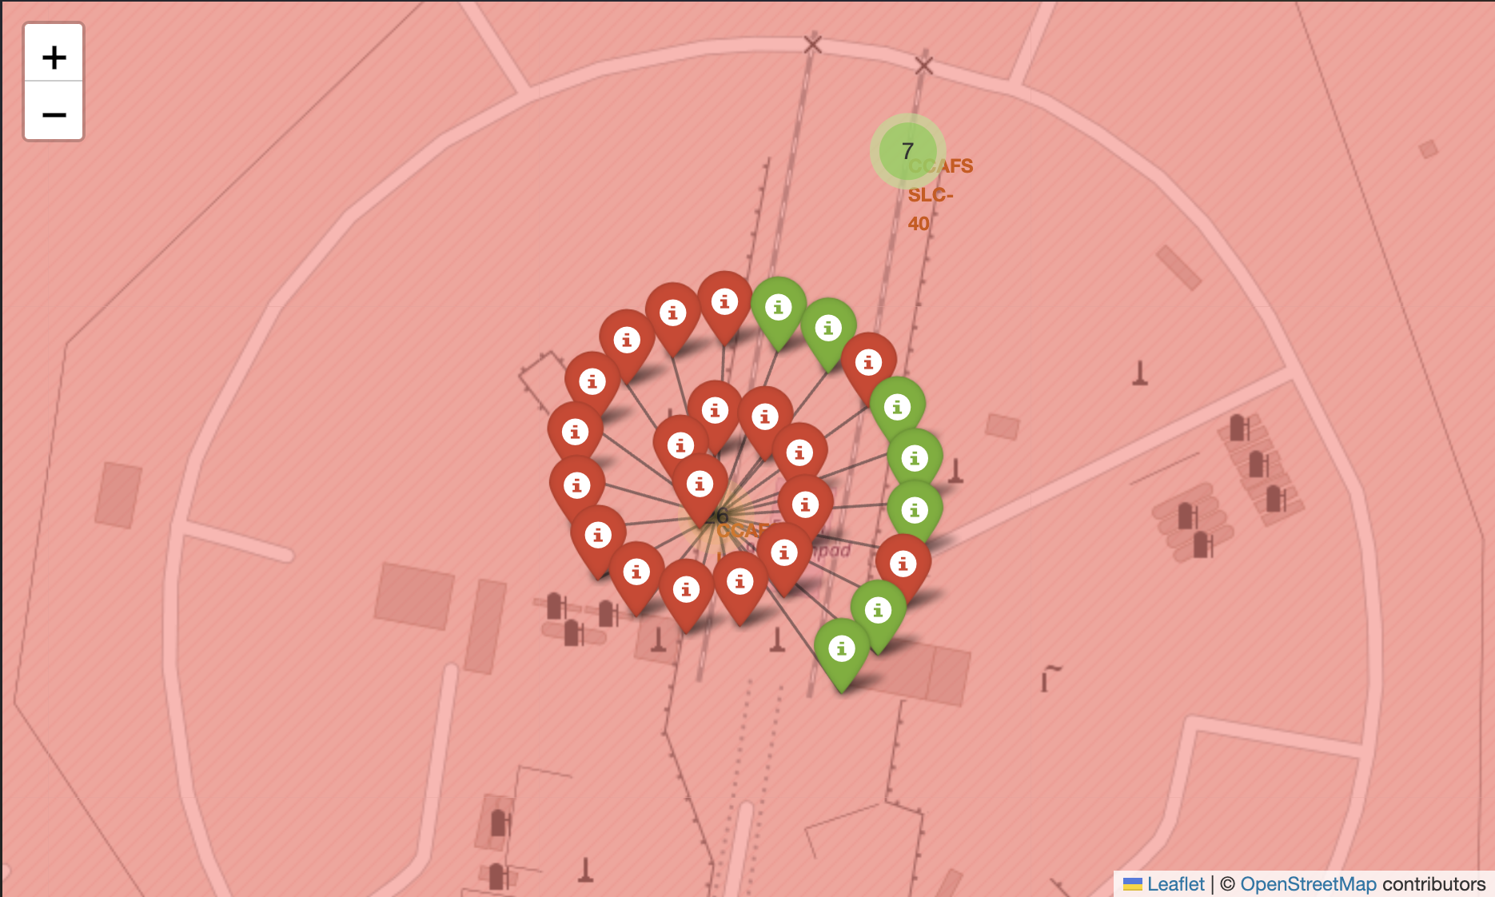
SpaceX Launch Outcome Markers
This map markers display all of the registers from the launch site "CCAFS LC-40", being 26 in total. The failed outcomes appear in red, and the successful ones in green.

Slide 38
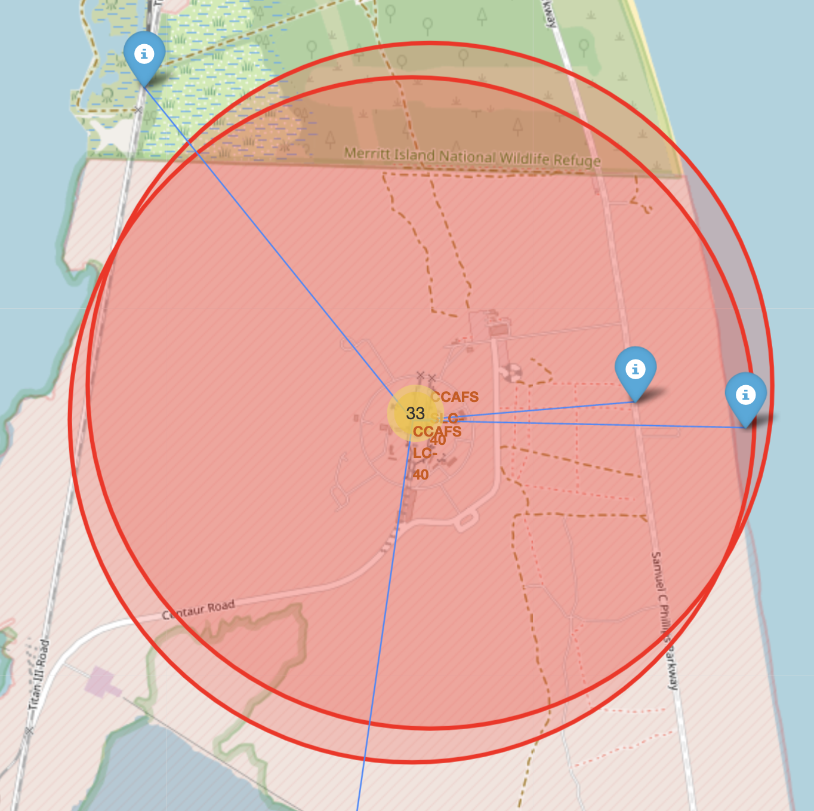
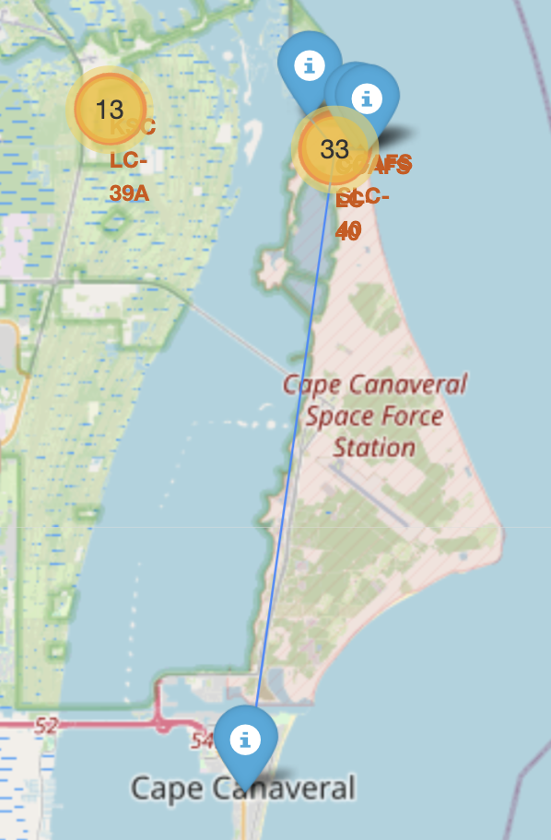
SpaceX Launch Sites' Nearby Locations
This map markers display some examples of the nearest locations of the launch site "CCAFS LC-40", such as the railway¹, highway², coastline³ and city⁴. This launch site is strategically positioned to have multiple solutions for goods and employees transport, and being close to populated areas and cities in case of emergency.

Slide 39

Section 4

Slide 40
Total Successful Launches per Site
This graph indicates that the launch site with the most successful missions is "KSC LC-39A", with 41.7%, followed by "CCAFS LC-40" with 29.2%
Dashboard: Pie Chart with "All Sites" in dropdown

Slide 41
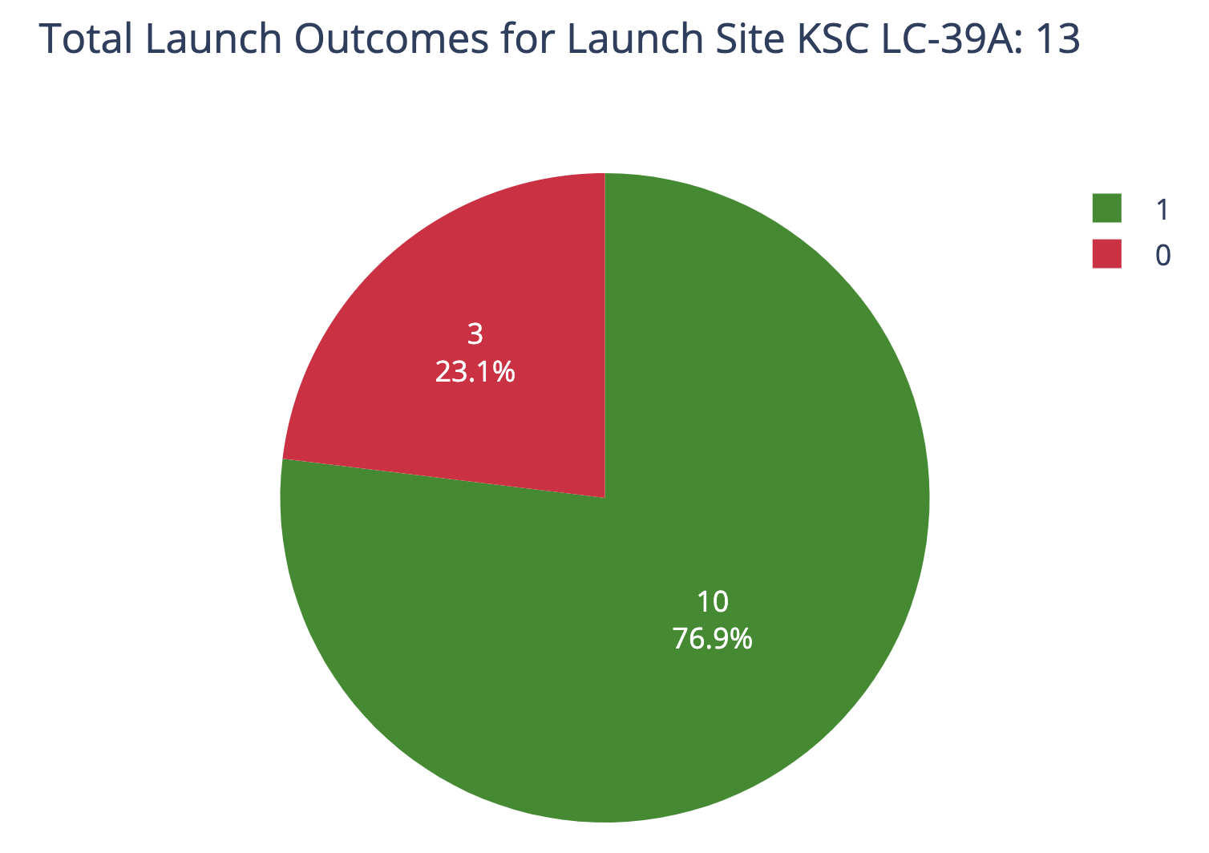
KSC LC-39A Launch Site Success/Failure Ratio
KSC LC-39A is the site with most successful launches, having a 76.9% of success rate. It is also the second launch site with the most missions assigned, with a total number of 13, while the site with the most launches is CCAFS LC-40, with 26 missions in total and a 26.9% success rate.
Dashboard: Pie Chart with "KSC LC-39A" in dropdown

Slide 42
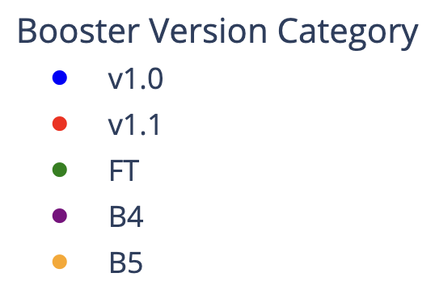
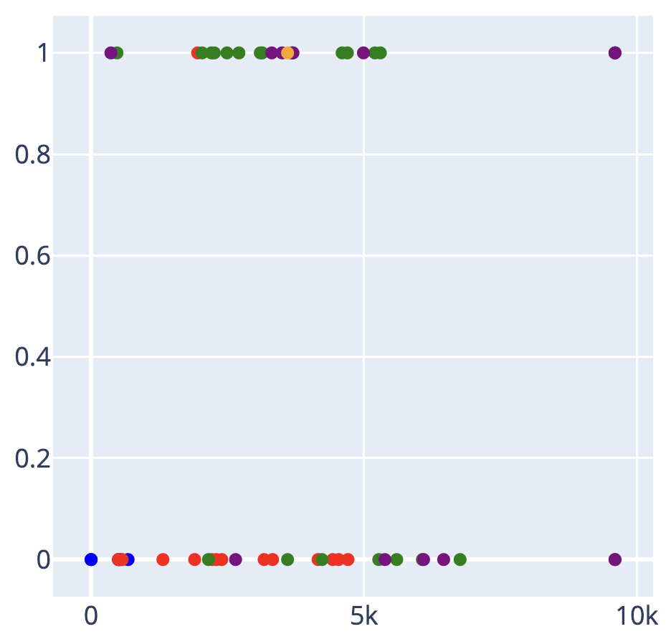
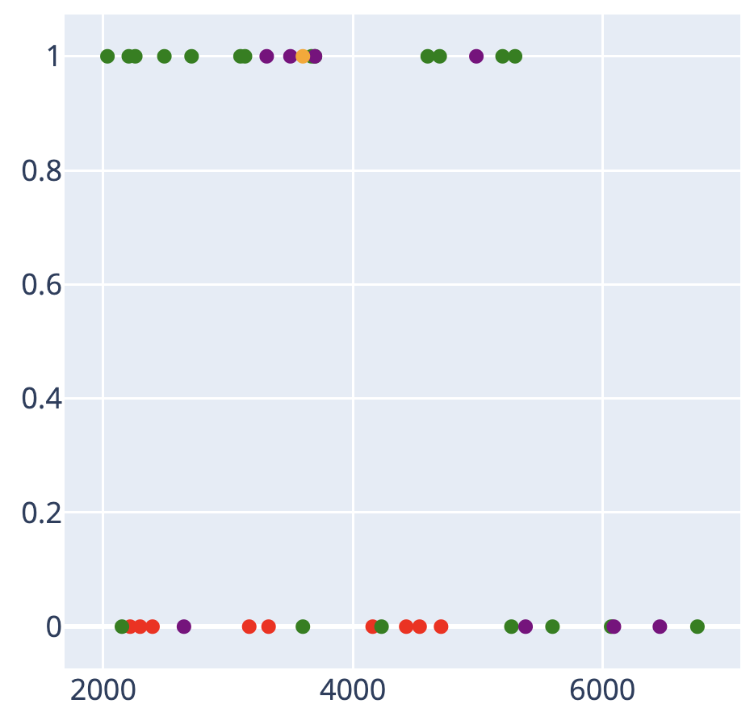
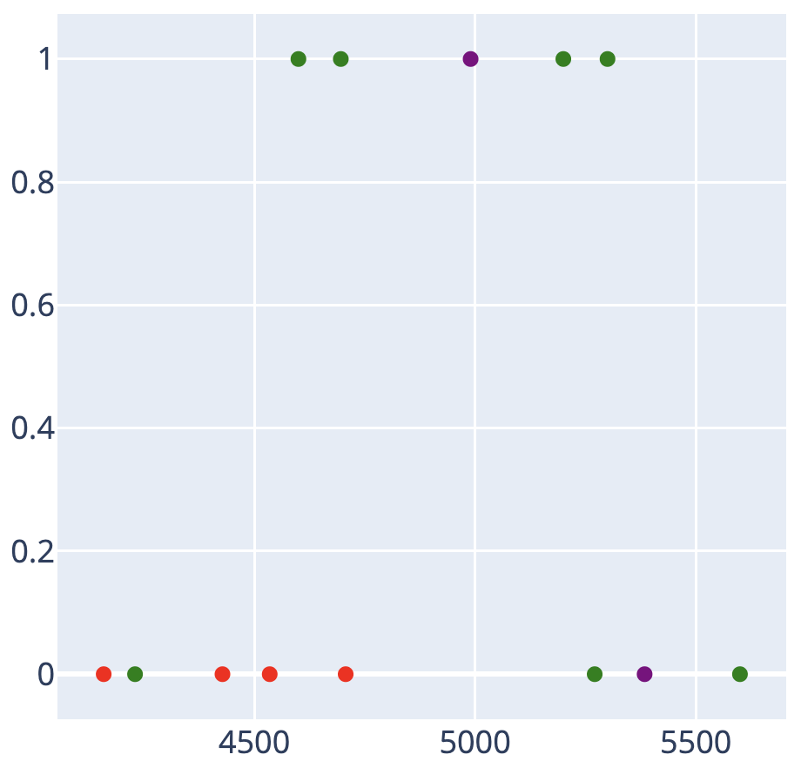
Payload Mass vs. Success Rate for All Sites
KSC LC-39A is the site with most successful launches, having a 76.9% of success rate. It is also the second launch site with the most missions assigned, with a total number of 13, while the site with the most launches is CCAFS LC-40, with 26 missions in total and a 26.9% success rate.
← Category →
← Payload Mass →
← Payload Mass →
← Payload Mass →
Catplot with no range
Catplot with range 2,000-8,000kg
Catplot with range 4,000-6,000kg

Slide 43

Section 5

Slide 44
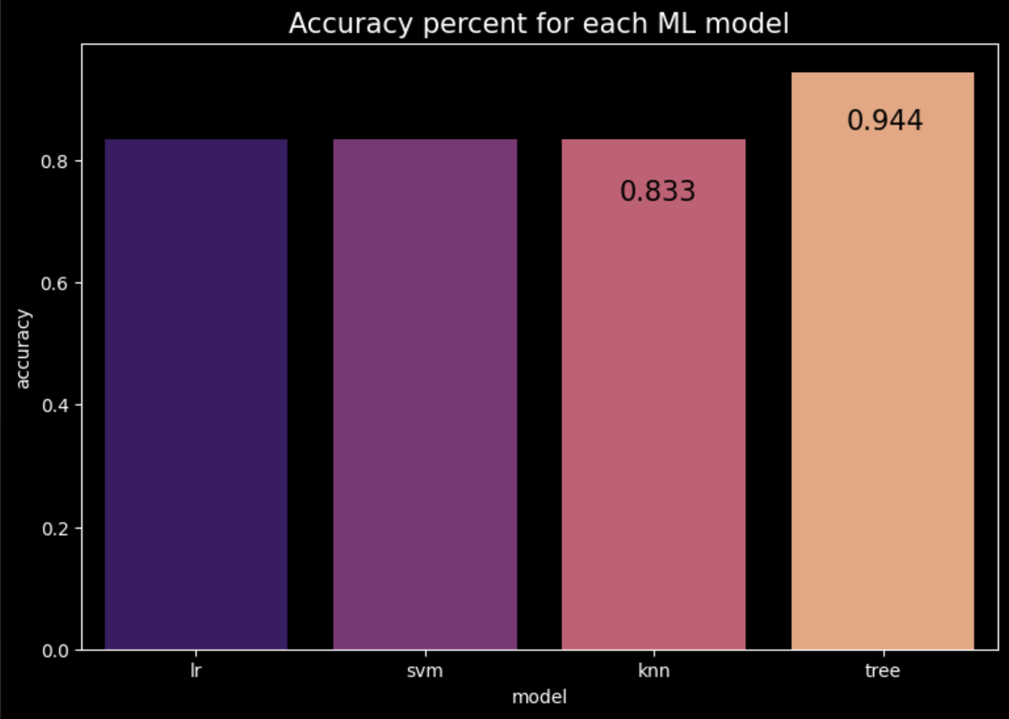
Classification Accuracy
Here we can see that the Decision Tree (Tree) was the highest in accuracy evaluation with a score of 94.4%. The other three models K-Nearest Neighbors (KNN), Support Vector Machine (SVM), and Linear Regression (LR) tied up with a 83.3% score
Model accuracy evaluation

Slide 45
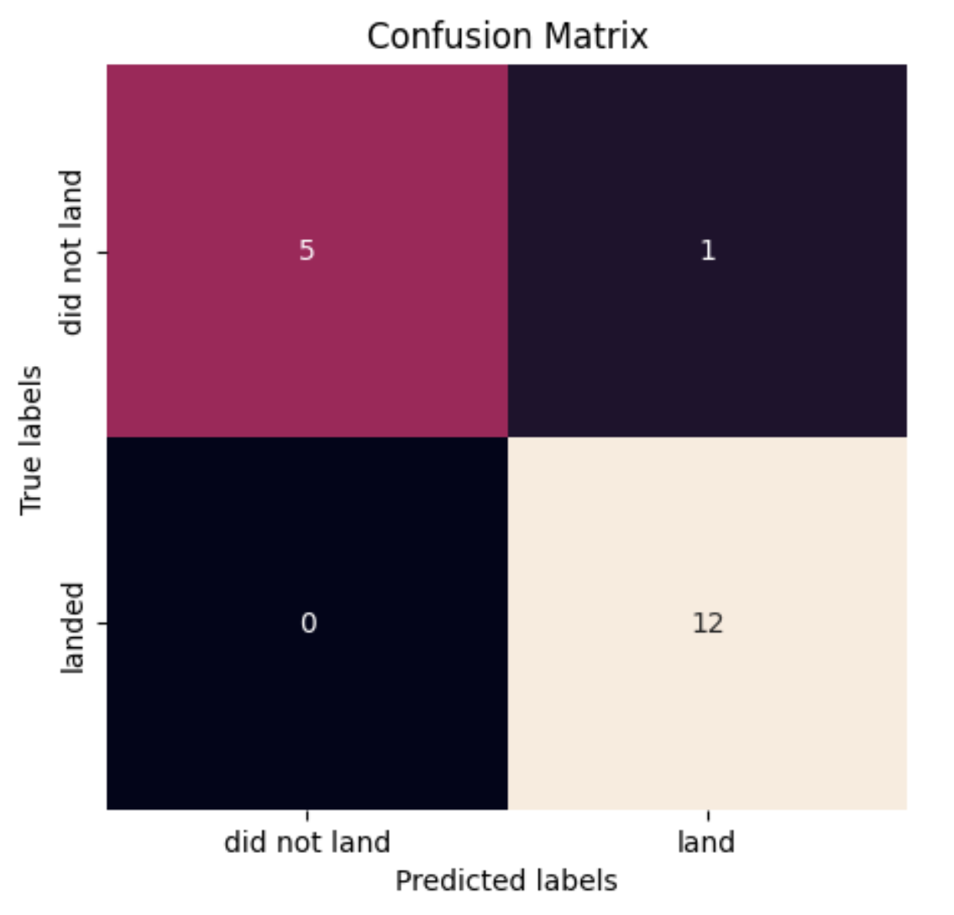
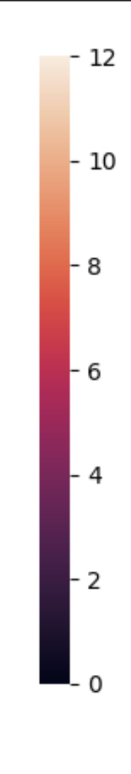
Confusion Matrix
We can appreciate that our Decision Tree Machine Learning model correctly predicted ALL of the successful launches (bottom-right) , and 5 out of 6 failed launches (top-left). The only mistake the model made was predicting one successful launch when in reality it was a failed one (top-right).
Confusion Matrix for Decision Tree Model

Slide 46
Conclusions
From the insights drawn, we now know that the success rate of a rocket launch increases as time and launch number increase. This makes sense as every SpaceX launch generates data, and new technologies and improvements come up over time.
The location of the launch sites are strategically planned in advance, positioned nearby coastlines, highways and railways, while being distant from cities and populated areas.
Without contemplating time, the rocket launch with the highest probability of success seems to be the SSO orbit with a payload mass of 500-4,000kg, having a success rate of 100%. This is viable because it is inside our payload average mass for FT booster version rockets. ES-L1, GEO and HEO orbits, which also have a success probability of 100% are excluded because of their low launch count.
The Machine Learning model that best performed, accuracy-wise, was the Decision Tree with the hyper parameters {'criterion': 'gini', 'max_depth': 12, 'max_features': 'sqrt', 'min_samples_leaf': 2, 'min_samples_split': 5, 'splitter': 'random'}. The model scored 94.4% on the accuracy test, while the others (LR, SVM and KNN) scored 83.3%

Slide 47
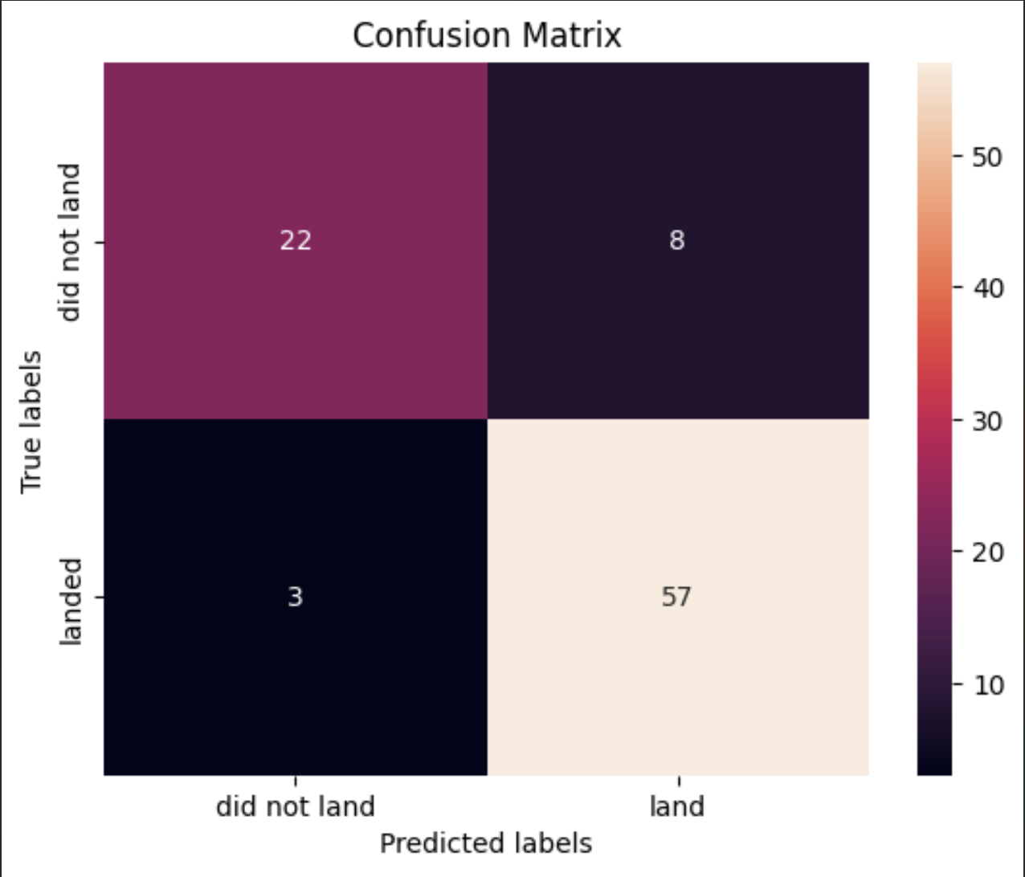
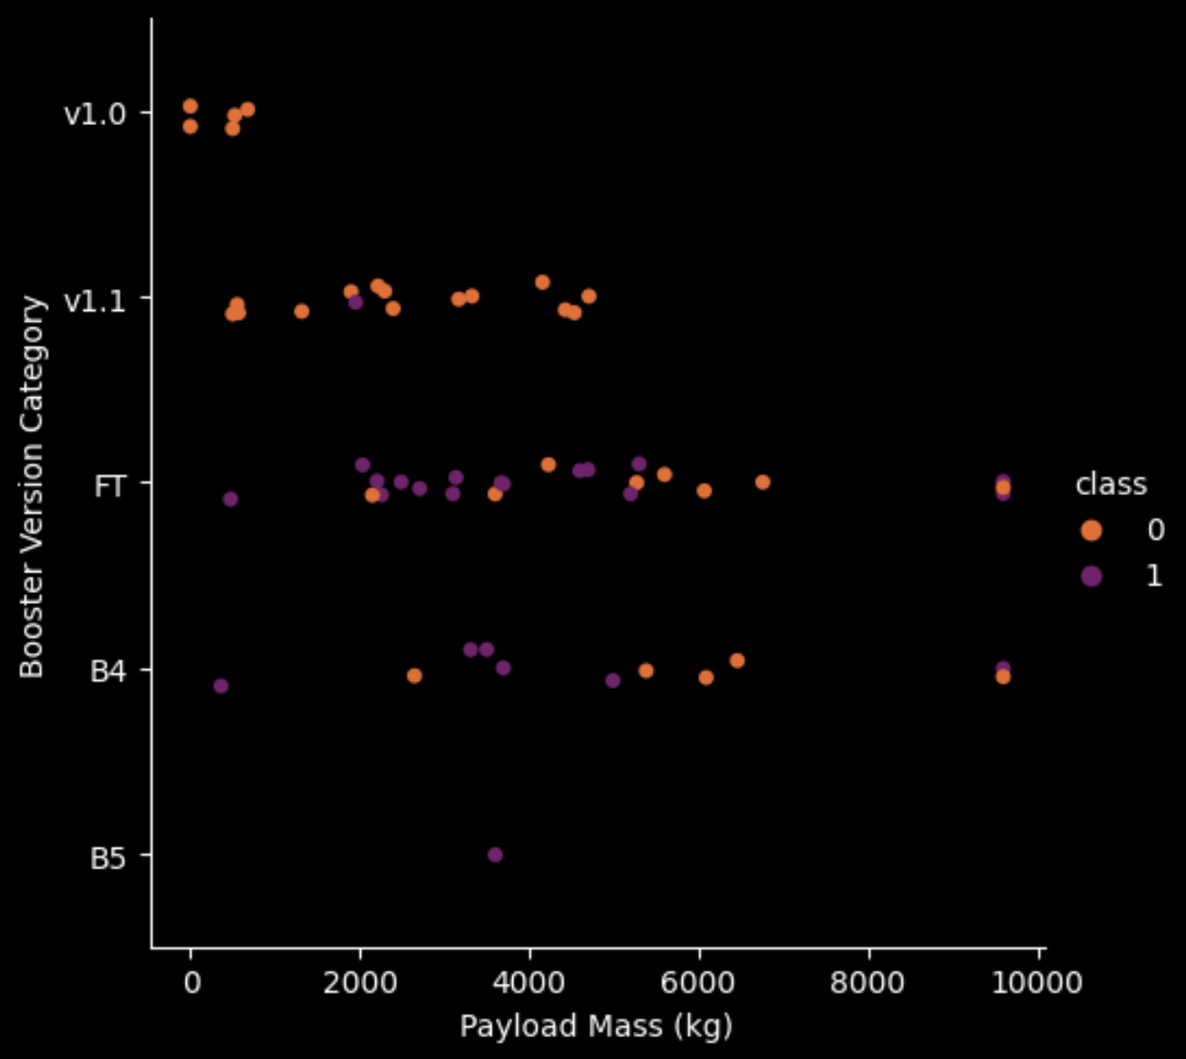
Appendix
This confusion matrix showcases the accuracy score when the Decision Tree model is trained with the entire dataset
This graph was generated afterwards to explain what the safest rocket launch was (Conclusion: Point 2), and why

Slide 48


